Slide 1

SSSS 2021 Cozart Tutorial
Set the Configuration for the Heart of the OS
Hsuan-Chi Kuo and SIBIN MOHAN
Dept. of Computer Science
University of Illinois at Urbana-ChampaigN
Notes:
Hello everyone. My name is Hsuan-Chi Kuo, a Phd student at UIUC, working with Prof. Sibin Mohan and Tianyin Xu.
Today, I will present our work, "Set the configuration for the heart of the OS: On the Practicality of Operating system kernel debloating", where we study the limitations of existing kernel debloating kernel techniques and share our insights of how to make kernel debloating more practical.

Slide 2

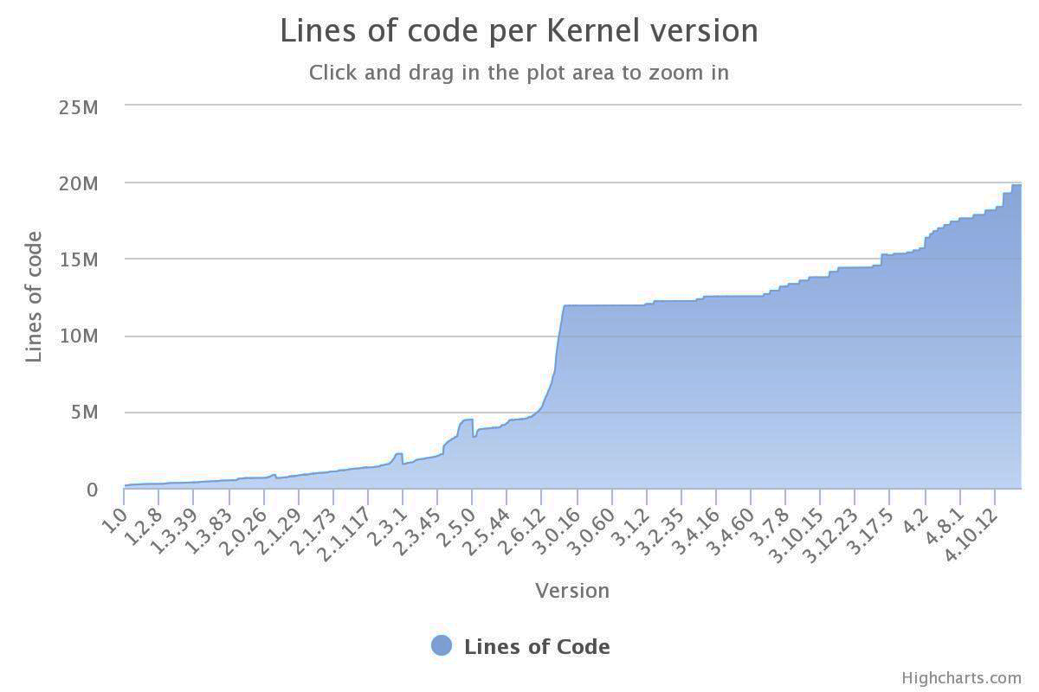
Commodity Operating Systems are Bloated!
Notes:
This figure shows the increase of lines of code for the Linux kernel.
By now, Linux has more than 20 millions lines and it still keeps growing.
So Linux is eventually bloated.

Slide 3
OS Bloat
Legacy code, dead code, driver code, etc.
Most applications do not need all kernel functionality
Notes:
OS bloat are due to tremendous amount of legacy support and new features.
Our study find that most applications do not need all the kernel functionality.

Slide 4
Problems with OS Bloat
Increased attack surfaces
Performance
Notes:
A bloat kernel could have problems such as security and performance.
For example, a larger kernel has bigger attack surface.
And unnecessary kernel code can bring down the performance.

Slide 5


Virtual Machines
Function-As-A-Service [FAAS]
Microservices
Large parts of kernel are unnecessary
Notes:
A recent trend of microservices and function-as-a-service emphasizes the problem of OS bloat because in such context, virtual machines are intended to run small and simple applications and large parts of kernels are not necessary.

Slide 6

Config-driven
Debloating
Kernel code
given an application, and its expected/known workloads, can we select only necessary kernel config options?
Notes:
This paper focuses on configuration-driven kernel deboating is that given an application and its workloads, we try to reduce the kernel to contain only the needed parts.

Slide 7
Configuration-driven debloating
de-facto technique
generates stable kernels
wide community support
reduce 50%-85% attack surface
hand-picking features -> impractical
  linux 4.14 -> 14,000+ options
incomplete/poor documentation
Notes:
Configuration-driven kernel debloating is the de-facto approach because it is supported by the Linux community and follows the kernel design therefore generates the stable kernel.
However, hand-picking necessary options from thousands of optons is impractical. And the incomplete and poor kernel configuration documentation is also an obstacle.

Slide 8
What ARE Kernel Configurations?
Kernels have configuration options:
Statement-level
Function-level
Code Preprocessor Statements
Notes:
Kernel configuration options control the compiled binary by C languages preprocessor hints.
These hints can have different granularities such as statements or functions controlling if a piece of code is compiled into the kernel.

Slide 9
What ARE Kernel Configurations?
Kernels have configuration options:
Object-file Configuration Statements

Slide 10
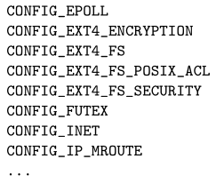

Automatic kernel debloating
Trace
Analyze
Build
Correlate
App
App
App
Kernel
Kernel
Kernel
Notes:
This is an overview of how config-driven kernel debloating works.
Trace the kernel running the target workloads and analyze what parts of the kernel are used.
Then correlate the kernel parts with configuration options and finally compile the debloated kernel with the options.

Slide 11

This Project
Identify five major limitations
Cozart: OS debloating framework
Notes:
This paper presents five limitations of configuration-driven kernel debloating techniques; two of them are essential and three of them are accidentals.
Essential limitations are inherent in the nature or assumptions of kernel debloating.
Accidental limitations are the flaws of existing apporaches.
Our tool cozart addresses these three accidental limitations.

Slide 12
Limitations of existing approaches
Addressed in Cozart!
Essence: inherent in the nature/assumptions
Accidents: flaws of existing tools
Difficulties in covering the complete kernel footprint
Not distinguishing what is executed vs what is needed
No visibility of kernel boot phases
Don't support fast application deployment
Coarse-grained tracing

Slide 13

Cozart
[Configuration Mozart]
Framework for debloating OS kernels using Configuration options
Notes:
In this paper, we design an advanced kernel debloating tool called Cozart that we use as a viechle to conduct our studies.

Slide 14
Cozart
Fully-automatic
Produce stable kernel
Fast-application deployment
Does not interfere application behavior
Notes:
OS bloat are due to tremendous amount of legacy support and new features.
Our study find that most applications do not need all the kernel functionality.

Slide 15
Cozart-configlets
baselets
Configuration options
Used to boot a kernel on a deployment environment [e.g. VM]
“configlets”
applets
Configuration options
Needed by target application [e.g. httpd]
Firecracker baselet
httpd applet
Notes:
Cozart divides the configuration into configlets for the deployment environments and applications.
Configlets are a set of configuration options.
Basetlets are configlets for different deployment environments and applets are configlets to support applications.
These are examples of a basetlet for firecracker hypervisor and an applet for the apapche web server.

Slide 16
Tracking configuration options
Offline phase
QEMU -> open-source emulator and virtualizer
Track kernel configurations : during execution of target application
  Tracing program counters (PCs) of application
  Mapping PCs to source code
  Correlate code lines to config option(s)
Loadable Kernel Modules (LKMs) require additional handling
Notes:
Cozart tracks the configuration options at the offline phase.
We patched QEMU to trace program counters and map PCs to the corresponding state- ment in the source code to understand which kernel module is used during the kernel execution.
Using a full system emulator enables us to trace the boot phase which is critical to produce a stable kernel.
Loadable kernel modules (LKMs) need additional handling since they are not part of the kernel binary, they are not loaded into memory at a fixed address.

Slide 17
Configlets, again!
Baselets, applets -> generated during tracing process
A “landmark” program -> marks end of boot phase
Cozart filters out hardware-related options : baselets
  From boot phase observations
  E.g. correlate with source code in: /arch, /drivers, /sound, etc.
Remaining config options -> applets
Notes:
Configlets are generated during the tracing process.
A landmark program marks the end of the boot phase.
Hardware-related options forms the basetlets and the remaining options are applets.

Slide 18
Building the kernel
kernel build systems [KBuild for Linux]
Build debloated kernels based on the composed configlets
Cozart optimized by incremental build
  If configs change -> only rebuild modules with configuration changes
Notes:
When configlets are prepared, cozart builds the kernel by combing and composing configlets.
Cozart also leverages the incremental build feature to speed up the kernel building process by only building things that need to be rebuilt.

Slide 19
Cozart framework
ONLINE
Kernel source files
Kernel Composer
Kernel Builder
Debloated KERNEL
src file
Vanilla KERNEL
OFFLINE
Config tracker
Configlet DB
Baselet
Applet1
Configlet generator
Applet2
Applet3
Application workloads
Notes:
This diagram shows how cozart works in a pipeline.
Cozart takes three inputs: kernel source code, vanilla kernel and application workloads.
Then config tracker would trace the applications and configlet generator produces configlets and store them into a database.
These steps take place offline.
In the online phase, kernel composer compose configets stored in the database and generates the final configuration.
Kernel build uses the final configuration to compile the debloated kernel.

Slide 20





Cozart evaluation
Boot times
Application Performance
Memory savings
Kernel Size reduction
Validation
Notes:
So now, let's take a look at evaluation.
We evaluated boot times, application performance, memory savings and kernel size.
We also validate if the debloated kernel changes applications execution.

Slide 21
Evaluation setup
Applications |  | Benchmarks |  | Test Suites
Name | Ver | Name | Metrics
httpd | 2.4 | Apache ab | RPS | Apache-Test
nginx | 1.15 | Apache ab | RPS | Nginx-test
Memcached | 1.5 | Memtier | RPS | Memcached/t
MySQL | 5.7 | Sysbench | Throughput | MySQL test
PHP | 7.2 | PHP Performance | Execution Time | PHP-test
Redis | 4.0 | Redis Benchmark | Throughput | Redis-test
Kernels:
Baseline: Ubuntu 18.10 Kernel 4.18.0 [also Fedora 30, kernel 5.1.19]
L4/Fiasco microkernel
Amazon Firecracker kernel [microVM]
Notes:
We use both benchmarks and test suites for six popular applications
Our baseline is Ubuntu kernel since it is the most well used one in the cloud servers.
We also applied cozart to other kernels such as L4 microkernel and amazon MicroVM.

Slide 22
Implementation details
KVM-based VM [4 VCPUs, 8 GB RAM]
Intel Xeon Silver 4110 CPU, 64 GB RAM
Language/tool | Lines of Code
Python | 447
bash | 1981
awk | 84
make | 101
Notes:
This is the machine setup for the evaluation and the implementation details of cozart.

Slide 23
The obvious kernel debloating results
Application | # Remaining Kernel Modules |  | Kernel Size Reduction [%]
 | Static | LKM | Static | LKM
Ubuntu Vanilla [Baseline] | 2443 | 5001 | 0 | 0
Notes:
This table shows the kernel reduction for applications.
We measure the number of kernel modules and kernel size.

Slide 24
The obvious kernel debloating results
Application | # Remaining Kernel Modules |  | Kernel Size Reduction [%]
 | Static | LKM | Static | LKM
Ubuntu Vanilla [Baseline] | 2443 | 5001 | 0 | 0
Base Configlet | 1212 | 7 | 17.21 | 86.80
Apache httpd | 1213 | 7 | 17.19 | 86.80
memcached | 1215 | 7 | 17.19 | 86.80
MySQL | 1221 | 7 | 17.13 | 86.80
nginx | 1215 | 7 | 17.19 | 86.80
PHP | 1216 | 7 | 17.21 | 86.80
Redis | 1217 | 7 | 17.71 | 86.80
Notes:
Cozart is able to reduce the kernel significantly.
The similar reduction result is due to that these kernels share the same basetlet.

Slide 25
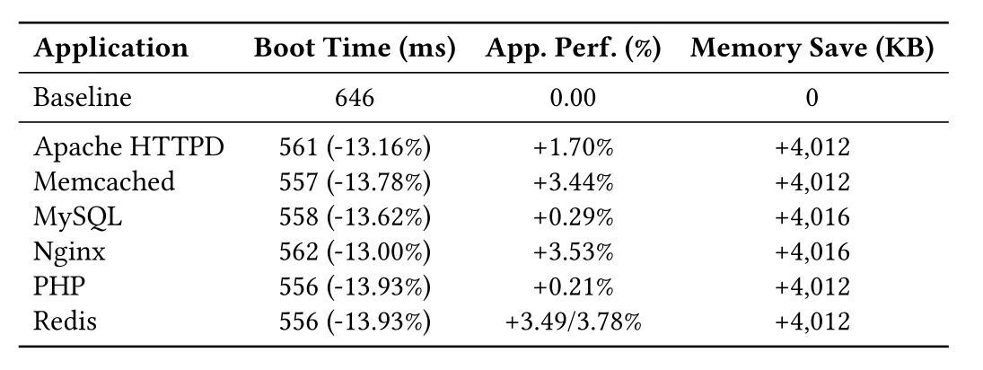
IMPROVED PERFORMANCE
Notes:
Cozart is able to reduce the kernel significantly.
The similar reduction result is due to that these kernels share the same basetlet.

Slide 26
The more interesting, Validation results!
Application running on debloated kernel -> same behavior as original
  Compare: (output, error, log) messages
Coverage: application code coverage and profiling -> remains the same
  Use `gcov’ and `gprof’ tools
Notes:
We also need to ensure that cozart does not alter applications' behavior.
Therefore we validate this by checking the log messages and application test suite coverage results.
During the evaluation, we did not see any differences in output or error messages.

Slide 27
The more interesting, Validation results!
Code coverage tests carried out using the `gcov’ tool

Slide 28
The more interesting, Validation results!
Application | Test Suite
 | Vanilla
 | LOC | Total | %
memcached | 5580 | 7635 | 73
Redis | 16392 | 29845 | 54
nginx | 43182 | 62493 | 69
Code coverage tests carried out using the `gcov’ tool
Notes:
We run test suites for applications on the vanilla kernel and the debloated kernel.

Slide 29
The more interesting, Validation results!
Application | Test Suite
 | Vanilla |  |  | Debloated
 | LOC | Total | % | LOC | Total | %
memcached | 5580 | 7635 | 73 | 5586 | 7635 | 73
Redis | 16392 | 29845 | 54 | 16774 | 29854 | 56
nginx | 43182 | 62493 | 69 | 43438 | 62776 | 69
Code coverage of debloated kernel closely matches original
Code coverage tests carried out using the `gcov’ tool
Notes:
We show the coverage of debloated kernels matches the vanilla ones.

Slide 30
The more interesting, Validation results!
Application | Test Suite |  |  |  |  |  | Benchmarks
 | Vanilla |  |  | Debloated |  |  | Vanilla
 | LOC | Total | % | LOC | Total | % | LOC | Total | %
memcached | 5580 | 7635 | 73 | 5586 | 7635 | 73 | 2033 | 7586 | 26
Redis | 16392 | 29845 | 54 | 16774 | 29854 | 56 | 3107 | 29562 | 10
nginx | 43182 | 62493 | 69 | 43438 | 62776 | 69 | 5557 | 62321 | 8
Code coverage tests carried out using the `gcov’ tool
Notes:
We also do this comparison using benchmarks and we get the same coverage.

Slide 31
The more interesting, Validation results!
Application | Test Suite |  |  |  |  |  | Benchmarks
 | Vanilla |  |  | Debloated |  |  | Vanilla |  |  | Debloated
 | LOC | Total | % | LOC | Total | % | LOC | Total | % | LOC | Total | %
memcached | 5580 | 7635 | 73 | 5586 | 7635 | 73 | 2033 | 7586 | 26 | 2031 | 7586 | 26
Redis | 16392 | 29845 | 54 | 16774 | 29854 | 56 | 3107 | 29562 | 10 | 3282 | 29564 | 11
nginx | 43182 | 62493 | 69 | 43438 | 62776 | 69 | 5557 | 62321 | 8 | 5557 | 62321 | 8
Benchmarks are much worse than test suites at testing/enumerating behavior of application!
Code coverage tests carried out using the `gcov’ tool
Notes:
But when comparing the converge results. Benchmarks are much worse than test suites at testing behavior of applications.

Slide 32
Thanks!
https://synercys.github.io
Notes:
Thank you very much!

Slide 33
DEMO
Debloat Ubuntu kernel for NGINX web server
Steps
  Setup the environment
  Trace the workloads to generate configlets
  Compose the configlets
  Test the debloated kernel

Slide 34
Setup
Trace
Compose
Test
Packed in a container image
We have set it up for you (partially)
Enter the container
  $ sudo docker start cozart
  $ sudo docker exec -it cozart /bin/bash
In the container bash prompt:
  $ cd /Cozart && source constant.sh

Slide 35
Setup
Trace
Compose
Test
$ make build-db
  Parse kernel source code
  C directives
  Makefiles

Slide 36
Setup
Trace
Compose
Test
To generate configlets!
  Baselet for boot
  Applet for NGINX
QEMU traces the program counter during VM execution
  Map the program counter to source code lines
  Map source code lines to kernel configs

Slide 37
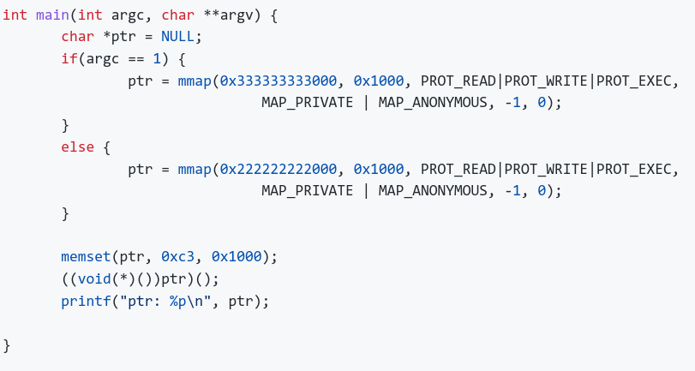
Trace
Compose
Test
To only capture the trace during NGINX execution
  A landmark program
Setup
Notes:
Show nginx script

Slide 38
Setup
Trace
Compose
Test
Configlets are ready
Combing configlets to get final kernel configuration

Slide 39
insights
Six insights obtained from config-based debloating
Notes:
Finally, I would like to share six insights that we learned.

Slide 40
1. Existing kernel debloating techniques initiate in-kernel tracing methods too late
Boot phrase is not observed
  critical to produce working/stable kernel
Notes:
First, in-kernel tracing methods are initialized too late and unable to observe the boot phase.
And the boot phase is critical to produce stable kernels.

Slide 41
2. Kernel debloating can be done within tens of seconds
Cozart’s composability allows users to prepare configlets offline
Composing configlets removes the tracing out of the critical path
Notes:
Second, Kernel debloating can be done within tens of seconds.
By using configlets, cozart can remove the tracing, which is the most time-consuming stage, out of the critical path.

Slide 42
3. Instruction-level tracing can address options that control intra-function features
Function-level tracing [ftrace] does not address options at statement granularity.
Statement-level
Function-level
Notes:
Function level tracing does not address all the configuration options.
Cozart uses instruction-level tracing to control intra-function features.

Slide 43
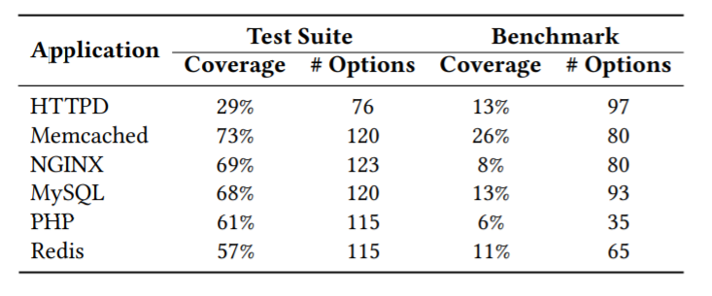
4. Imperfect test suites and benchmarks
Low test coverage of open-source projects
Combining benchmarks and test suites alleviates this limitation to some extent
Notes:
Existing kernel debloating techniques rely on tracing.
Ideally, applications should be 100% exercised during tracing.
However, we found that test suites coverages are not as high as expected and benchmarks are much lower.

Slide 44
5. Domain-specific information can further debloat the kernel
Used but not necessary modules
  E.g. CPU freq/temp management
Xenconfig and kvmconfig as baselets further reduce the kernel size by 40%
Notes:
We discovered an fundamental limitation which is the inability to distinguish used but not necessary modules during tracing.
So in some baselets, some options are unnecessary. Domain-specific information can help to remove such options.
For example, if we know that we are going to deploy the kernel on Xen, we can use xenconfig as the baselet and this can further reduce the kernel by 40%.

Slide 45
6. Kernel debloating is effective for other kernels
L4 microkernel : 47% reduction
Firecracker MicroVM kernel: 19.76%
  still Linux but highly specialized
Notes:
Finally, We also found that cozart can also effectively debloat other types of kernel including L4 microkernel and Firecraker microvm.

Slide 46
Setup
Trace
Compose
Test
Check the debloating result
Verify NGINX still works

Slide 47
Benefits of Domain/platform-specific information

