Slide 1


PMP: Forced Execution to Disclose Hidden Malware Behavior
SSSS Tutorial 2021
Xiangyu Zhang (Presenter)
Zhou Xuan, Xiangzhe Xu, and Zhuo Zhang (TAs)
Purdue University

Slide 2

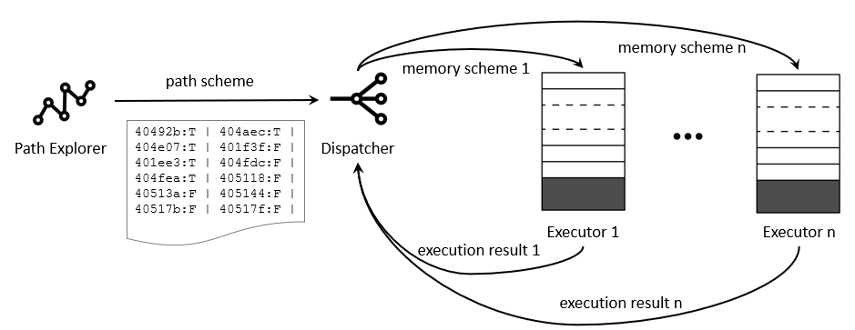
What is PMP
PMP is a powerful malware/program analysis engine that excels at disclosing hidden malicious behaviors
  Operates on stripped binaries
  Forces any malware/program to run along a large set of paths, suppressing any input or environmental requirements (e.g., the presence of C&C server or a special device) – plug and run
  Penetrates malware self-protection such as time/logic-bomb and cloaking, and forces it to expose itself
  Discloses three times of the malicious behaviors by VirusTotal
  PMP’s predecessor has identified 149 popular iOS apps with hidden backdoor behaviors (all immediately brought down by Apple)

Slide 3
Outline
Malware
Malware defense
Malware analysis
  System logging
  Program analysis
  Forced execution

Slide 4
Malware
Virus
Virus infects existing files. Once infected, a virus will lay dormant until the file is opened and in use
2. Worm
Unlike viruses, worms do not need host programs/files to disseminate
3. Trojan
Provides desirable functionality but has hidden malicious operation, including Remote Access Trojans (RATs), Internet Relay Chat (IRC) bots, keylogging Trojans
4. Spyware
Runs secretly on a computer
Reports back sensitive information to a remote user or grant remote access to attackers
(https://www.cisco.com/c/en/us/products/security/advanced-malware-protection/what-is-malware.html)
Notes:
Virus is contagious, it usually infects existing files
IRC bots: internet relay chat bots, it appears like someone is chatting. But it is indeed a program

Slide 5
Malware
5. Adware
Collects data on a victim’s computer and pushes the corresponding advertisements that serve the attacker’s purposes
Some can even contain Trojan horses and spyware
6. Ransomware
Encrypts sensitive information within a system
Demands a financial payout for the data
7. Fileless malware
A type of memory-resident malware
Operates from memory, not from files on the hard drive
Harder to detect because there are no files to scan
Disappears when the victim computer is rebooted
(https://www.cisco.com/c/en/us/products/security/advanced-malware-protection/what-is-malware.html)

Slide 6
Example: Ransomware
WannaCry ransomware attack
A worldwide cyberattack in May 2017 by the WannaCry ransomware cryptoworm, which targeted computers running the Microsoft Windows operating system by encrypting data and demanding ransom payments in the Bitcoin cryptocurrency
The attack was estimated to have affected more than 200,000 computers across 150 countries, with total damages ranging from hundreds of millions to billions of dollars.
https://en.wikipedia.org/wiki/WannaCry_ransomware_attack

Slide 7
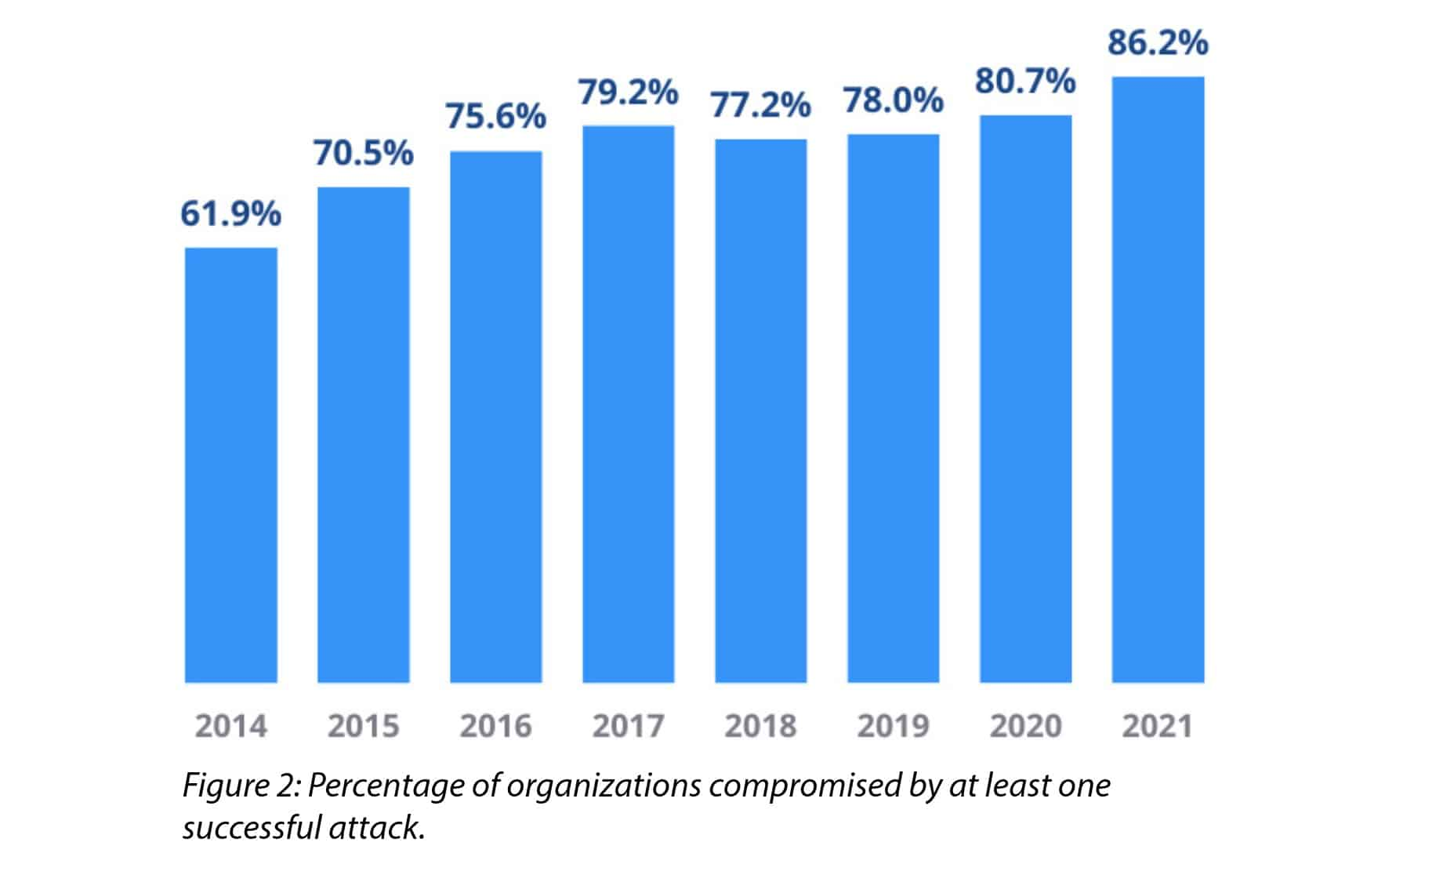
Malware Is a Major Security Threat
  There were 137.7 million new malware samples in 2020, 92.45 million new samples in 2021 up to 6/29
  86.2% of surveyed organizations were aﬀected by a successful cyberattack (CyberEdge’21)
https://www.comparitech.com/vpn/cybersecurity-cyber-crime-statistics-facts-trends/

Slide 8
Malware Is a Major Security Threat
  In 2019, 93.6% of malware observed was polymorphic, meaning it has the ability to constantly change its code to evade detection (2020 Webroot Threat Report)
  Since 2016, a total of 172 ransomware attacks have cost US healthcare organizations $21 billion. (Comparitech)
  Almost 200 million ransomware attacks occurred in the first nine months of 2020 representing a large increase over the previous year. (SonicWall)
  One out of five Americans has dealt with a ransomware attack. (The Harris Poll)
  …
https://www.comparitech.com/vpn/cybersecurity-cyber-crime-statistics-facts-trends/

Slide 9
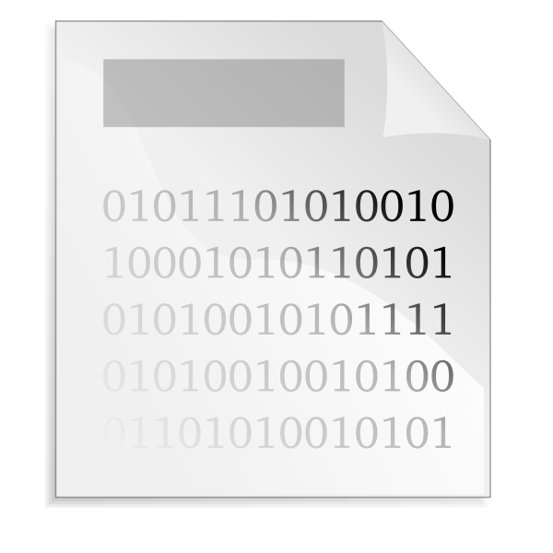



How Malware Works
Insertion: Mechanism which enables it to install itself on the target system
A malware disguises itself as a harmless document or program and tricks users into installing it, like a seemingly benign email attachment or pop-up ad warning that your computer has a virus
Notes:
https://newtecservices.ie/malware-exploit-attacks-explained/

Slide 10

How Malware Works
2. Cloaking: Mechanisms in place to avoid detection
Notes:
https://newtecservices.ie/malware-exploit-attacks-explained/

Slide 11
Cloaking – Time/Logic Bomb
The playload is only delivered at a certain date/time, or when certain conditions are satisfied
  For example, when resource consumption is larger than a threshold
Notes:
https://www.ekkosec.com/blog/2018/3/15/linux-anti-vm-how-does-linux-malware-detect-running-in-a-virtual-machine-

Slide 12
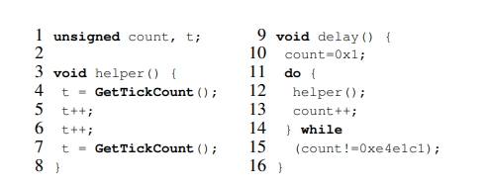
Cloaking - stalling loop
To evade sandboxing, delay the execution of the malicious activity long enough so that an automated dynamic analysis system fails to extract the interesting malicious behavior
GetTickCount() retrieves the number of milliseconds that have elapsed since the system was started. It is typically used to measure the time that elapses between two events.
Notes:
Https://sites.cs.ucsb.edu/~chris/research/doc/ccs11_loops.pdf
The below code snippets are decompiled from a real malware.
The delay function is invoked at the beginning of the malware main body

Slide 13
Cloaking - VM Detection
VM is widely used as a sandbox in malware analysis
Once a VM environment is detected, the evasion mechanism may prevent the malicious code from running, or alter the malware’s behavior to avoid exposing malicious activities.
For example, when running on real hardware the malware will connect to its Command and Control (C&C) server, but when a VM is detected it will connect to a legitimate domain causing the analyst or the security system to believe this is legitimate code.
Notes:
https://www.ekkosec.com/blog/2018/3/15/linux-anti-vm-how-does-linux-malware-detect-running-in-a-virtual-machine-

Slide 14
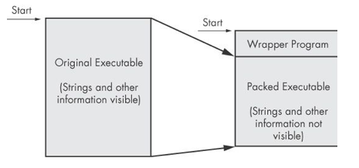
Cloaking – Obfuscation and Packing
The code is compressed, like a Zip file
This makes the strings and instructions unreadable
All you'll see is the wrapper – small code that unpacks the file when it is run

Slide 15


How Malware Works
3. C&C server
Command-and-Control (C&C) Server
Notes:
ISA 562, Information Security, Theory and Practice.
Lecture 10: Malware
https://newtecservices.ie/malware-exploit-attacks-explained/

Slide 16
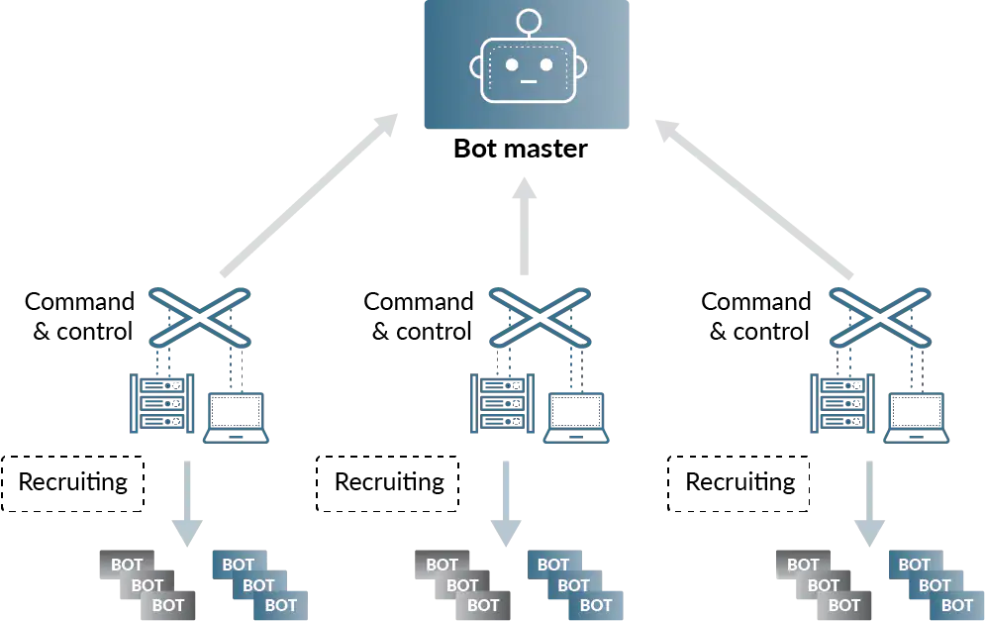
Command and Control (C&C)
Refers to how attackers communicate and exhibit control of the infected system
Most common today: HTTP/HTTPS; Others: P2P, DNS tunneling bypass firewalls/network-based detection systems and to blend in with the legitimate web traffic
Many infected machines form a Botnet
Notes:
https://terrorgum.com/tfox/books/learningmalwareanalysis_ebook.pdf
https://www.paloaltonetworks.com/cyberpedia/command-and-control-explained

Slide 17

How Malware Works
Trigger: an event that initiates its payload (e.g. time and date, mouse click)
  It is a kind of cloaking too
Notes:
https://newtecservices.ie/malware-exploit-attacks-explained/

Slide 18

How Malware Works
5. Payload: carries out the malicious function (e.g. format the hard drive, install a backdoor, and exploit vulnerability)
Notes:
https://newtecservices.ie/malware-exploit-attacks-explained/

Slide 19
Typical Payloads
Amusing or annoying pranks
Destroy/corrupt files and applications
Monitor and transmit user activity (spyware, logger)
Install backdoor (makes the infected computer a zombie)
Send spam
Launch denial-of-service attack
Alter browser settings to display ads
Dial out international or 900 numbers (dialer)
Cryptomining
…

Slide 20

How Malware Works
6. Eradication: removes itself after the payload has been executed
Notes:
https://newtecservices.ie/malware-exploit-attacks-explained/

Slide 21
How Malware Works
7. Replication: the ability to create copies of itself and to propagate to other machines (e.g. Worm)
Notes:
https://newtecservices.ie/malware-exploit-attacks-explained/

Slide 22
Outline
Malware
Malware defense
Malware analysis
  System logging
  Program analysis
  Forced execution

Slide 23
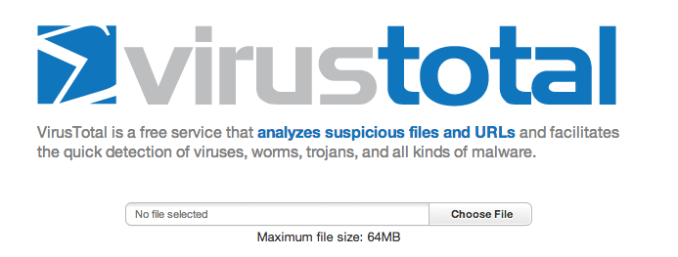



Existing Malware Defense
Signature/feature based detection
  Search for a specific finger print
  Collect features (byte sequences and their frequences) and use a classifier
  Pros: fast, effective in practice
  Cons: cannot handle polymorphic malware and zero-day malware; tremendous efforts to maintain up-to-date signatures
Behavior based detection
  Run it inside a sandbox and observes its behaviors
  Pros: resilience to mutants; handles new malware
  Cons: expensive; easy to evade by cloaking
Collecting and checking goodware’s checksums

Slide 24
Outline
Malware
Malware defense
Malware analysis
  Audit logging
  Program analysis
  Forced execution

Slide 25
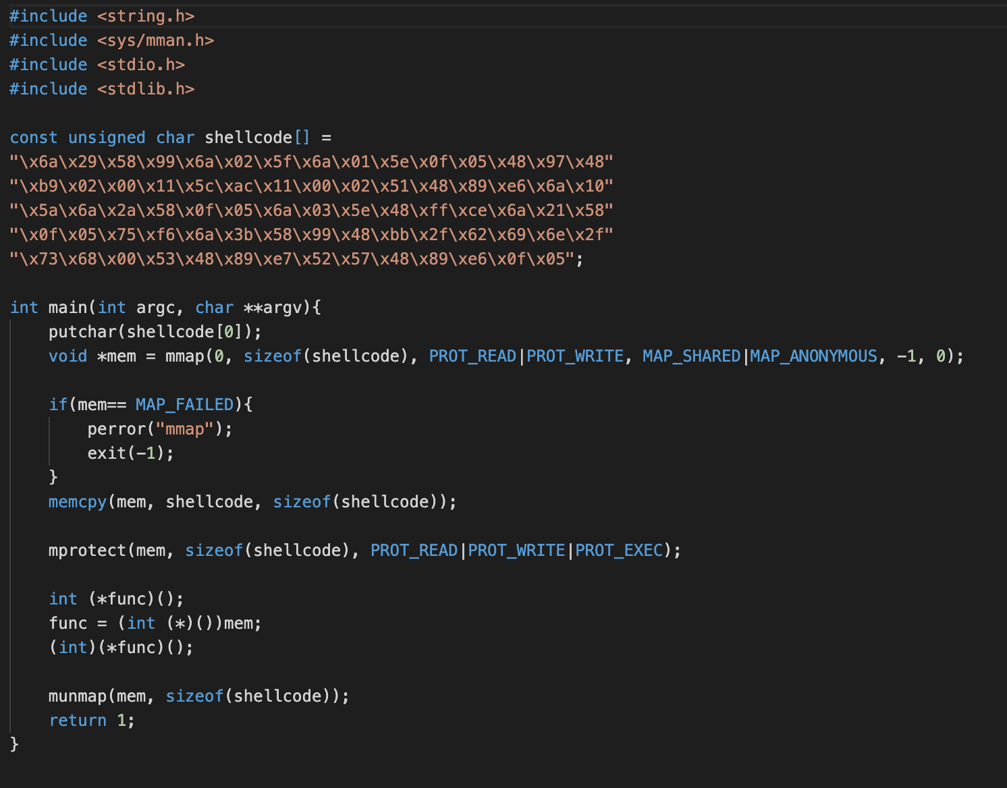
A Simple Malware

Slide 26
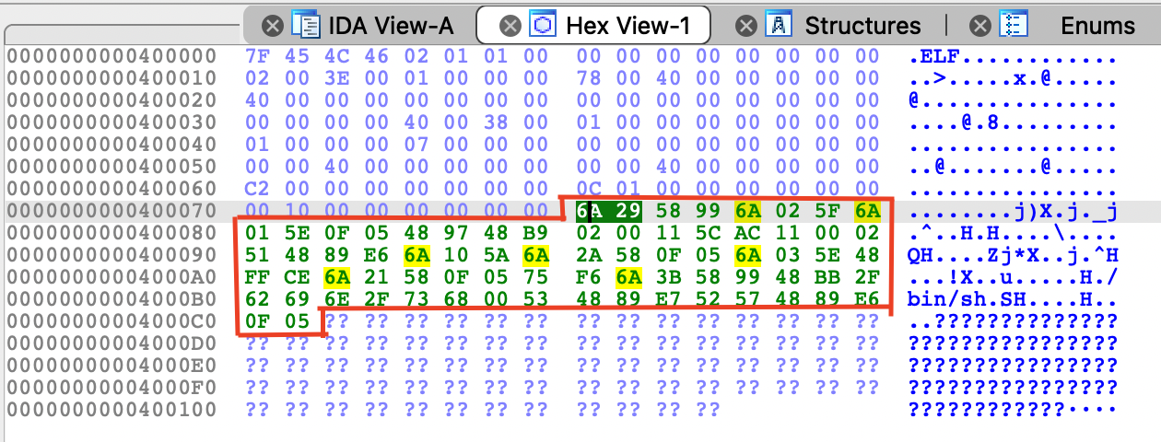
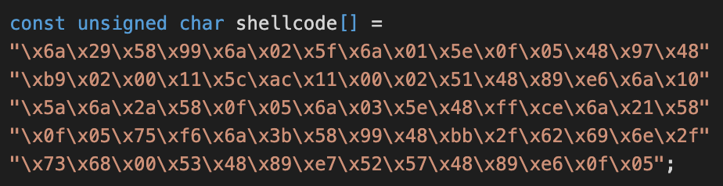
Malware Example
A piece of shellcode(payload) generated by MSF (Metasploit Framework, a tool for developing and executing exploit code against a remote target machine) on Kali

Slide 27
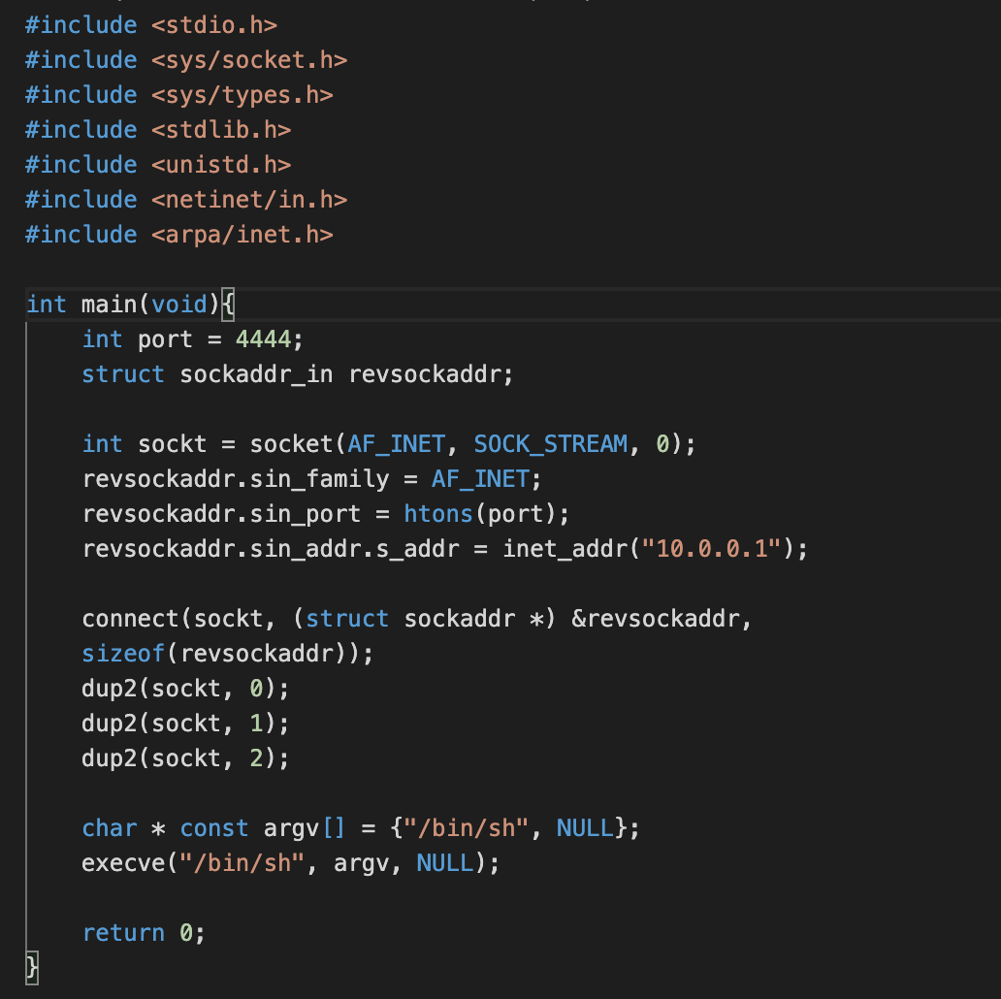
Shellcode(Payload) - Reverse Shell
socket() and connect() create a socket connecting to the attacker’s machine
dup2()s redirect std I/O to the socket
A port of attacker’s machine keeps listening. When execve executes “bin/bash”, the input
and output of the shell are directed to the
attacker which means the attacker gets the
shell

Slide 28
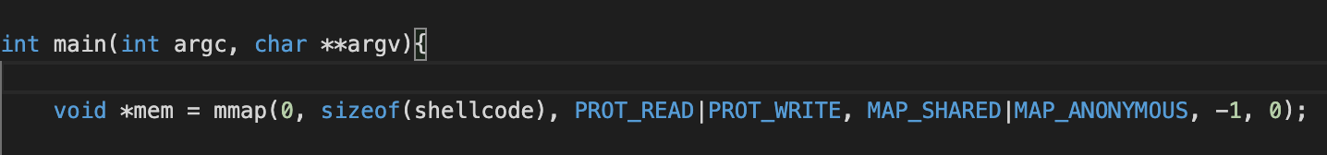
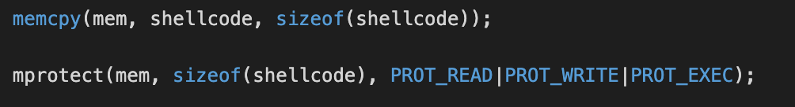
Malware Example
Map a memory area in the virtual address space of the calling process with read and write protection
Move the content in shellcode array to the memory and makes the memory region executable

Slide 29




Malware Example
Define ‘func’ as a pointer pointing to a function with no parameters and int return value.
It's for casting ‘mem’ to a pointer to a function which has no parameter () and returns int. Then it assigns that pointer to “func”.
It runs the function which is pointed by “func”.
It unmaps the memory region.

Slide 30
Outline
Malware
Malware defense
Malware analysis
  Audit logging
  Program analysis
  Forced execution

Slide 31
Audit Logging (in Sandbox)
Audit logging records system level events during program execution
  System calls: system services provided by the kernel
    spawn/terminate a process, file creation/read/write, socket creation/read/write, memory map, etc.

Slide 32
Linux Audit Architecture
Netlink
auditd
Kernel
File open syscall
PRE_FILE_OPEN event
OPEN_FILE event
User
Task
Syscall
Application
Exit
POST_FILE_OPEN event
Exclude
Notes:
Kernel module

Slide 33
Linux Audit
Event entry in audit log
  Event type
type=SYSCALL (02/10/14 16:28:20.782) : syscall=open exit=3 a0=912e98
type=PATH : name=/etc/file1 inode=12345 mod=file,744
ppid=2537 pid=2557 comm=vim exe=/bin/vim
uid=tom gid=tom euid=tom
< Audit log entry for a file open event >

Slide 34
Linux Audit
Event entry in audit log
  Event type
  File information
type=SYSCALL (02/10/14 16:28:20.782) : syscall=open exit=3 a0=912e98
type=PATH : name=/etc/file1 inode=12345 mod=file,744
ppid=2537 pid=2557 comm=vim exe=/bin/vim
uid=tom gid=tom euid=tom
< Audit log entry for a file open event >

Slide 35
Linux Audit
Event entry in audit log
  Event type
  File information
  Process information
type=SYSCALL (02/10/14 16:28:20.782) : syscall=open exit=3 a0=912e98
type=PATH : name=/etc/file1 inode=12345 mod=file,744
ppid=2537 pid=2557 comm=vim exe=/bin/vim
uid=tom gid=tom euid=tom
< Audit log entry for a file open event >

Slide 36
Linux Audit
Event entry in audit log
  Event type
  File information
  Process information
  User information
type=SYSCALL (02/10/14 16:28:20.782) : syscall=open exit=3 a0=912e98
type=PATH : name=/etc/file1 inode=12345 mod=file,744
ppid=2537 pid=2557 comm=vim exe=/bin/vim
uid=tom gid=tom euid=tom
< Audit log entry for a file open event >

Slide 37
System Causal Graph
Analyze audit logs to generate a causal graph
Proc_A recv <x.x.x.x>
Proc_A fork Malware
Audit Log

Slide 38
System Causal Graph
Analyze audit logs to generate a causal graph
  Backward analysis - identify the source of an attack
Proc_A recv <x.x.x.x>
Proc_A fork Malware
Malware write File1
Malware write File2
Audit Log
: Process
: File
: Network Socket
: Event

Slide 39
System Causal Graph
Analyze audit logs to generate a causal graph
  Backward analysis - identify the source of an attack
Proc_A recv <x.x.x.x>
Proc_A fork Malware
Malware write File1
Malware write File2
Audit Log
Process A
Malware
: Process
: File
: Network Socket
: Event

Slide 40
System Causal Graph
Analyze audit logs to generate a causal graph
  Backward analysis - identify the source of an attack
Proc_A recv <x.x.x.x>
Proc_A fork Malware
Audit Log
x.x.x.x
Process A
Malware
: Process
: File
: Network Socket
: Event

Slide 41
System Causal Graph – Forward Analysis
Analyze audit logs to generate a causal graph
  Forward analysis - Understand damage to a system
Proc_A recv <x.x.x.x>
Proc_A fork Malware
Malware write File1
Malware write File2
Audit Log
Malware
: Process
: File
: Network Socket
: Event

Slide 42
System Causal Graph – Forward Analysis
Analyze audit logs to generate a causal graph
  Forward analysis - Understand damage to a system
Proc_A recv <x.x.x.x>
Proc_A fork Malware
Malware write File1
Malware write File2
Audit Log
Malware
File 1
: Process
: File
: Network Socket
: Event

Slide 43
System Causal Graph – Forward Analysis
Analyze audit logs to generate a causal graph
  Forward analysis - Understand damage to a system
Proc_A recv <x.x.x.x>
Proc_A fork Malware
Malware write File1
Malware write File2
Audit Log
Malware
File 1
File 2
: Process
: File
: Network Socket
: Event

Slide 44

Audit Logging - Example
Social engineering attack by phishing e-mail

Slide 45
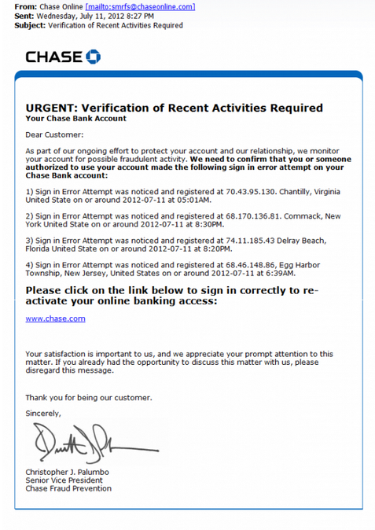
Example
Social engineering Attack by phishing e-mail

Slide 46
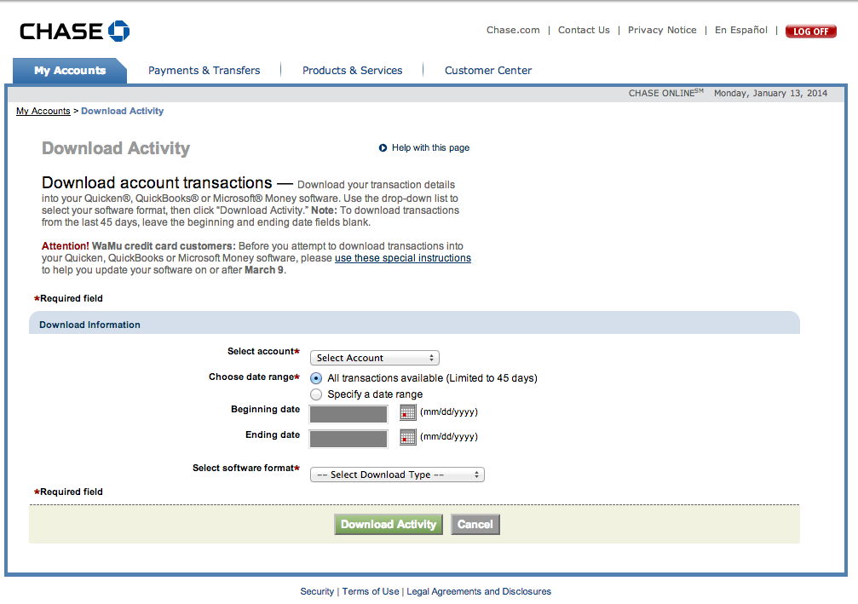
Attack provenance - Example
Social Engineering Attack
  Phishing e-mail with a phishing link

Slide 47
Attack provenance - Example
Social Engineering Attack
  Phishing e-mail with a phishing link

Slide 48

Attack provenance - Example
Social Engineering Attack
  Phishing e-mail with a phishing link

Slide 49
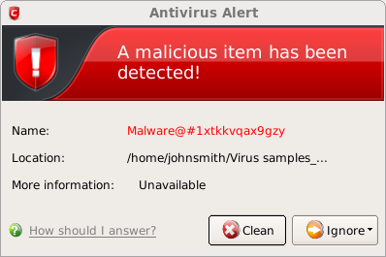

Slide 50
[ Backward Analysis ]
Malware

Slide 51
[ Backward Analysis ]
Firefox
Malware

Slide 52
[ Backward Analysis ]
The user visited 11 web sites
(229 IP Addresses)
. . .
Firefox
Malware

Slide 53
[ Backward Analysis ]
Email client
. . .
Firefox
Malware

Slide 54
[ Backward Analysis ]
. . .
sendmail
sendmail
sendmail
sendmail
sendmail
. . .
procmail
procmail
procmail
procmail
message1
message2
. . .
message13
message14
Email client
. . .
Firefox
Malware

Slide 55
[ Backward Analysis ]
. . .
sendmail
sendmail
sendmail
sendmail
sendmail
. . .
procmail
procmail
procmail
procmail
message1
message2
. . .
message13
message14
Email client
. . .
Firefox
Malware

Slide 56
[ Backward Analysis ]
. . .
sendmail
sendmail
sendmail
sendmail
sendmail
. . .
procmail
procmail
procmail
procmail
message1
message2
. . .
message13
message14
Email client
. . .
Firefox
Malware

Slide 57
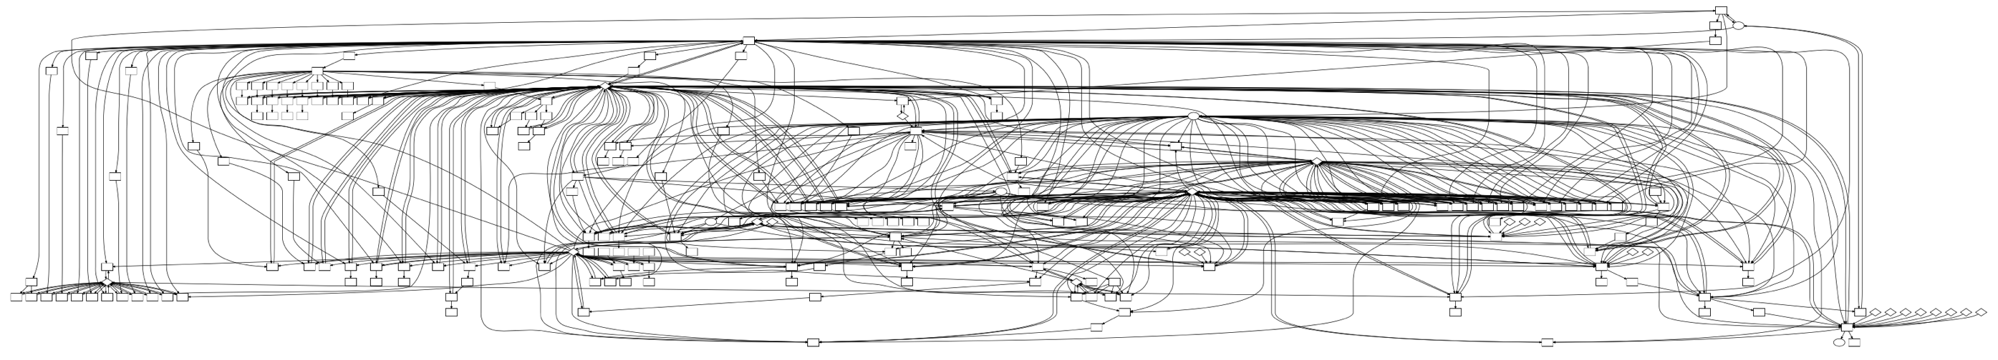
What a Real Causal Graph Looks Like

Slide 58
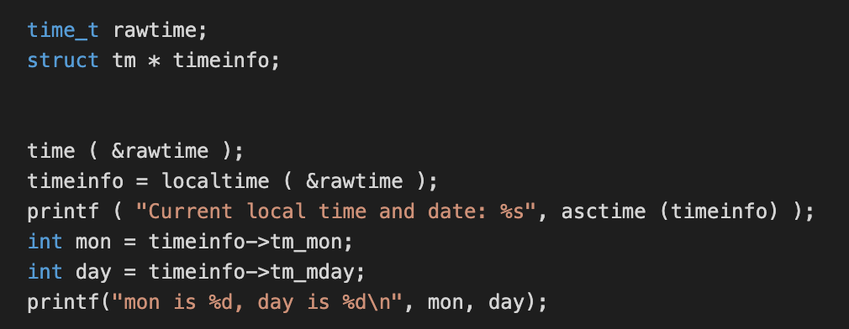
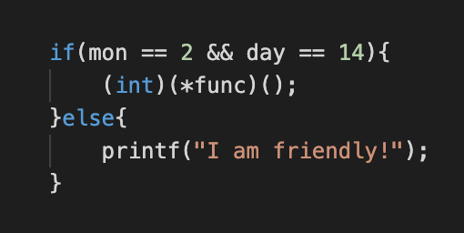
Evading Audit Logging by Cloaking
Cloaking by a time bomb
The shellcode can only be triggered on March 14th. When it is executed on other days, the malicious behavior can’t be observed

Slide 59
Exercises I-II Playing with the Malware
Click the “Start PMP tutorial” icon on your lab machine to start the PMP tutorial interface

Slide 60
Outline
Malware
Malware defense
Malware analysis
  Audit logging
  Program analysis
  Forced execution

Slide 61
Program Representations
Original representations
  Source code (language specific).
  Binaries (cross machines and platforms).
They are hard for machines to analyze.
Software is translated into certain representations before analyses are applied.

Slide 62
Control Flow Graph
A node is a basic block, which is a sequence of consecutive statements with a single entry and a single exit point. Thus a block has unique entry and exit points.
An edge between two nodes denotes the control transfer between the two
© Aditya P. Mathur 2005
Notes:
62

Slide 63
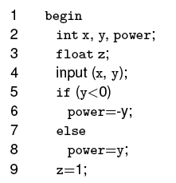
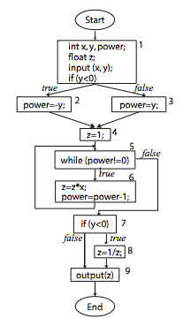
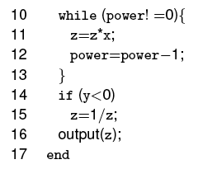
CFG Example
N={Start, 2-5, 6, 8, 9, 10, 11-12,
14, 15, 16, End}
E={(Start,2), (5, 6), (5, 8), (6,9),
(8, 9), (9, 10), (10, 11),
(12, 10), (10, 14), (14, 15),
(14, 16), (15, 16), (16, End)}
© Aditya P. Mathur 2005
Notes:
63

Slide 64
Paths
A program path is sequence of control flow edges in the CFG.
  A path is complete if it starts from the beginning of the program and ends at the termination
  A path is feasible if there exists some input that can cause the program execution to follow the path
  There are a large number infeasible paths in the real world programs
  1. if (x>0)
  2. S1;
  3. if (x<-10)
  4. S2;
  5. return
© Aditya P. Mathur 2005
Notes:
64

Slide 65
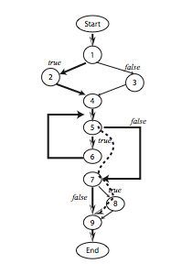
Example
An infeasible path:
p₁= ( Start, 2-5, 6, …14, 16, End)
© Aditya P. Mathur 2005
Notes:
65

Slide 66
Program Analysis
Static analysis – analyzing malware without executing it
  Pros: does not require inputs or the proper environment; scalability
  Cons: can be easily evaded by cloaking or obfuscation; inaccurate
  Examples: malware similarity analysis, malware finger-printing
Dynamic analysis – analyzing malware’s runtime behaviors
  Pros: accuracy; can penetrate obfuscation
  Cons: achieving good coverage may be challenging; can be evaded by time-bomb/logic-bomb kind of cloaking; requiring inputs and environment
  Examples: sandboxing, tracing, audit logging
Symbolic analysis – analyzing malware behaviors along all feasible paths by resolving path conditions (generating inputs that can take specific paths)
  Pros: accurate and complete
  Cons: not scalable; difficulty dealing with system dependences

Slide 67
Program Analysis
Static analysis – analyzing malware without executing it
  Pros: does not require inputs or the proper environment; scalability
  Cons: can be easily evaded by cloaking or obfuscation; inaccurate
  Examples: malware similarity analysis, malware finger-printing
Dynamic analysis – analyzing malware’s runtime behaviors
  Pros: accuracy; can penetrate obfuscation
  Cons: achieving good coverage may be challenging; can be evaded by time-bomb/logic-bomb kind of cloaking; requiring inputs and environment
  Examples: sandboxing, tracing, audit logging
Symbolic analysis – analyzing malware behaviors along all possible paths by resolving path conditions (generating inputs that can take specific paths)
  Pros: accurate and complete
  Cons: not scalable; having difficulty dealing with system dependences

Slide 68
Dynamic Analysis by Program Instrumentation
Given a subject program, program instrumentation automatically inserts additional statements/instructions or changes existing statement/instructions such that runtime behaviors can be collected/manipulated
  Intrusive and non-intrusive (the former may change existing program behaviors)
  Source based instrumentation
  Static binary instrumentation
  Dynamic binary instrumentation

Slide 69
The Simplest Instrumentation
Max = 0;
for (p = head; p; p = p->next)
{
if (p->value > max)
{
max = p->value;
}
}
printf(“In loop\n”);
printf(“True branch\n”);

Slide 70
Source Level Instrumentation
Read a source file and parse it into ASTs.
Annotate the parse trees with instrumentation.
Translate the annotated trees to a new source file.
Compile the new source.
Execute the program and a trace produced.
Notes:
Recall that a compiler works by first parsing source files into abstract syntax trees (ASTs). Intermediate code is generated based on the ASTs. Optimizations are applied and finally code is generated from the optimized intermediate code.
The idea of source level instrumentation is to add an extra step to the compiler, which is to produce a new AST from the original AST.

Slide 71
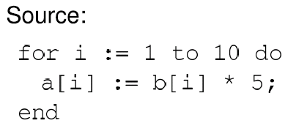
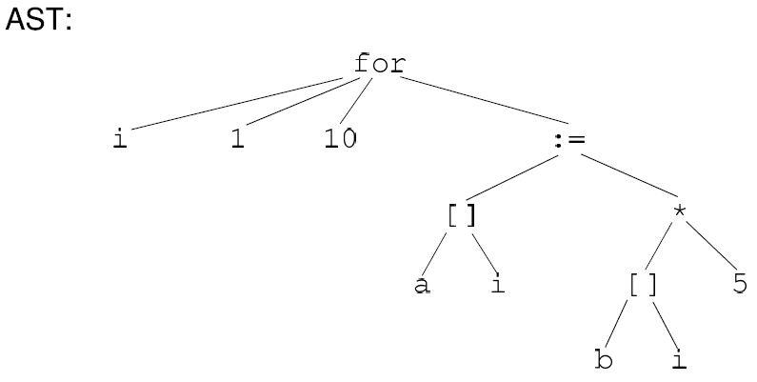
An Example

Slide 72
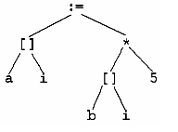
An Example
;
printf(“In loop\n”)
Notes:
Rewriting is often implemented using YACC.

Slide 73
Forced Execution by Instrumentation (PMP)
Goal: address the challenges in dynamic malware analysis
  Poor coverage
  Can be evaded by cloaking
  Requiring inputs and environment
Idea: force the program to take different paths by switching predicate outcomes (by instrumentation); and external inputs will be automatically filled in with random values (by instrumentation)
  Cloaking can be evaded

Slide 74
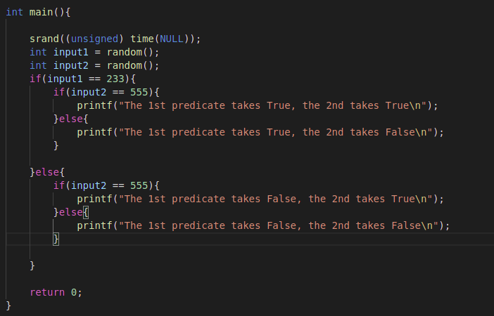
Example
The predicates almost always take the false branches

Slide 75
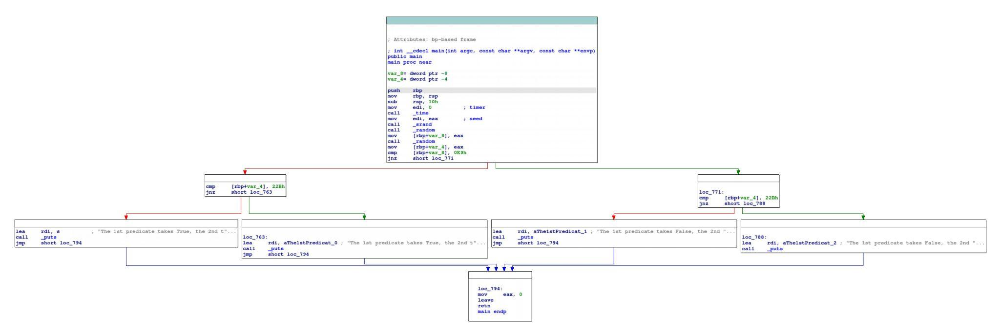
Forced Execution – Example
Control flow graph of the main function - 4 paths

Slide 76
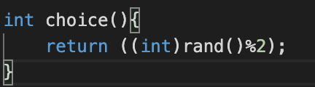
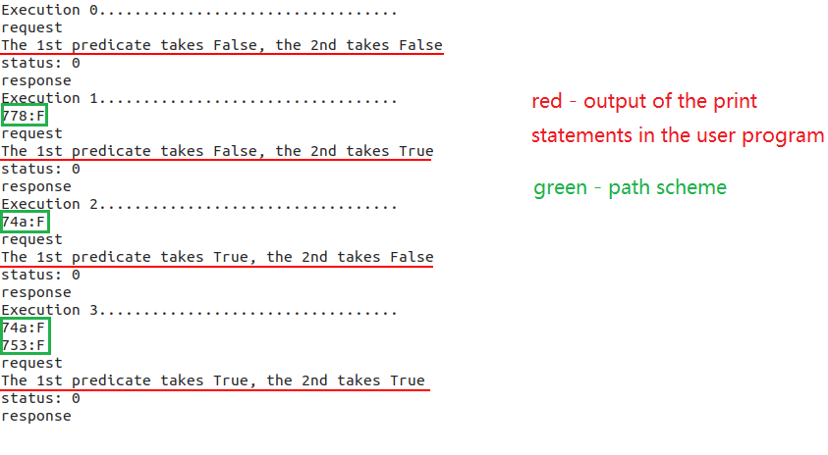
Forced-execution: Basic Idea
Replace all the Boolean expressions in conditional statements with an invocation to a choice() function – which randomly chooses true or false
In our previous example, all four paths will have a certain likelihood to be explored

Slide 77

Challenges in Forced Execution
Arbitrarily flipping branches may induce infeasible program paths and then crashes
  Objects are not properly allocated
  Pointers are having wrong values
Idea (PMP’s predecessor X-Force/iRis): allocate memory and fix pointer values on demand
  Intercept any memory accesses (by instrumentation) and make sure they are valid
  If not, allocate memory and fix the pointer

Slide 78
Challenges in Forced Execution
On demand allocation and pointer repair fail to consider pointer correlations
  A pointer is corrupted due to branch flipping (e.g., memory not allocated)
  Its gets copied to multiple variables
  When one of the variables is dereferenced, it is properly fixed (e.g., by allocating some new memory block). But the pointer variables that are correlated to the fixed one need to be repaired accordingly (to retain their correlations)
  Otherwise, the program semantics are broken
Solution – probabilistic memory preplanning (PMP)
  Pre-allocate a large piece of memory at the beginning (the playground)
  All pointer variables are initialized to some random addresses within the playground
  Any stack/heap objects are filled with values that point to addresses within the playground
  As a result, all pointers are valid to begin with
  What about pointer address collision (preplanning provides probabilistic guarantees)

Slide 79
Exercise III-V: Under the Hood of PMP
Go to the virtual machine
Click the corresponding buttons

Slide 80
Understanding Exercise V: On-demand Allocation
b:
NULL
p:
NULL
1234
input
T *b = NULL;
T *p = NULL;
int input = rand();
If (choice()) {
b = (T *)malloc(sizeof(T));
b->f3=&input;
}
p = b;
ondemand(&b)->f1 = 300.3;
ondemand(&b)->f2 = 200000000;
*ondemand(&(b->f3)) = 15;
…
printf (“…”, ondemand(&p)->f1);
300.3
f1
200000000
f2
f3
15
f1
f2
f3

Slide 81
Explaining Exercise V: Memory Preplanning
b:
void* playground[4096];
void memory_preplanning() {
for (int i=0;i<4096;i++)
playground[i]=(void*) &playground[rand()%4096];
}
T *b = (T*) (&playground[rand()%4096]);
T *p = (T*) (&playground[rand()%4096]);
int input = rand();
If (choice()) {
b = (T *)malloc(sizeof(T));
b->f3=&input;
}
p = b;
b->f1 = 300.3;
b->f2 = 200000000;
*b->f3=15;
printf (“…”, p->f1,…);
p:
1234
input
playground
15
f1:
300.3
f2:
20000000
f3:

Slide 82
Essence: Supporting Any Complex Dereferences
b:
void* playground[4096];
void memory_preplanning() {
for (int i=0;i<4096;i++)
playground[i]=(void*) &playground[rand()%4096];
}
T *b = (T*) (&playground[rand()%4096]);
T *p = (T*) (&playground[rand()%4096]);
int input = rand();
If (choice()) {
b = (T *)malloc(sizeof(T));
b->f3=&input;
}
p = b;
b->f1 = 300.3;
b->f2 = 200000000;
*b->f3=15;
printf (“…”, p->f1,…);
p:
input
playground
*(*(*(*b))))=15

Slide 83
Essence: Supporting Any Complex Dereferences
b:
void* playground[4096];
void memory_preplanning() {
for (int i=0;i<4096;i++)
playground[i]=(void*) &playground[rand()%4096];
}
T *b = (T*) (&playground[rand()%4096]);
T *p = (T*) (&playground[rand()%4096]);
int input = rand();
If (choice()) {
b = (T *)malloc(sizeof(T));
b->f3=&input;
}
p = b;
b->f1 = 300.3;
b->f2 = 200000000;
*b->f3=15;
printf (“…”, p->f1,…);
p:
input
playground
*(*(*(*b))))=15

Slide 84
Essence: Supporting Any Complex Dereferences
b:
void* playground[4096];
void memory_preplanning() {
for (int i=0;i<4096;i++)
playground[i]=(void*) &playground[rand()%4096];
}
T *b = (T*) (&playground[rand()%4096]);
T *p = (T*) (&playground[rand()%4096]);
int input = rand();
If (choice()) {
b = (T *)malloc(sizeof(T));
b->f3=&input;
}
p = b;
b->f1 = 300.3;
b->f2 = 200000000;
*b->f3=15;
printf (“…”, p->f1,…);
p:
input
playground
*(*(*(*b))))=15

Slide 85
Essence: Supporting Any Complex Dereferences
b:
void* playground[4096];
void memory_preplanning() {
for (int i=0;i<4096;i++)
playground[i]=(void*) &playground[rand()%4096];
}
T *b = (T*) (&playground[rand()%4096]);
T *p = (T*) (&playground[rand()%4096]);
int input = rand();
If (choice()) {
b = (T *)malloc(sizeof(T));
b->f3=&input;
}
p = b;
b->f1 = 300.3;
b->f2 = 200000000;
*b->f3=15;
printf (“…”, p->f1,…);
p:
input
playground
*(*(*(*b))))=15
15

Slide 86
PMP Architecture
M’ + predicate
flipping scheme 1
Audit logger
M’= M +
Preplanned memory
Audit logger
Malware M
QEMU
Path explorer
…
Audit logger
M’ + predicate
flipping scheme n
Audit logger
PMP: Cost-effective Forced Execution with Probabilistic Memory Pre-planning [S&P 2020]

Slide 87

Evaluation on
PMP reports more than twice syscall sequences of that of other tools
PMP is 9.8 times faster than X-Force
PMP yields 1.5 times longer path schemes than X-Force
(a) number of exposed syscall sequences (b) executions per second (c) length of path scheme
Notes:
The comparison is performed on different aspects, including the number of exposed system call sequences, execution speed and the length of path scheme.
The figures on this slide show the overall result.
As we can see that the executions with anti-evasion measures enabled (like what Cuckoo++ does) expose more system call sequences than the native executions (like what Cuckoo does), but disclose fewer than the forced execution methods (like what X-Force and PMP do). PMP reports more than twice system call sequences of that of other tools.
On average, PMP is 9.8 times faster than X-Force and yields path schemes with 1.5 times longer than X-Force. In general, the faster the execution speed, the longer the path schemes can be achieved within a limited time budget, which in turn results in the deeper the code was explored.

Slide 88
149 iOS Popular Apps with Hidden Behaviors (iRis)
Framework | API Name | Functionality | #Apps
SpringBoardServices | SBSSpringBoardServerPort | Initialize port with Springboard | 3
 | SBSCopyApplicationDisplayIdentifiers | Obtain ids of all running apps | 3
 | SBFrontmostApplicationDisplayIdentifier | Obtain id of the front most app | 3
 | SBSCopyLocalizedApplicationNameForDisplayIdentifier | Get app name from its id | 33
MobileCoreServices | [LSApplicationWorkspace defaultWorkspace] | Obtain the default workspace object | 2
 | [LSApplicationWorkspace allApplications] | Get all installed apps | 1
 | [LSApplicationWorkspace allInstalledApplications] | Get all installed apps | 1
 | [LSApplicationWorkspace applicationIsInstalled:] | Check if a specific app is installed | 1
Notes:
By and large the primary use of private APIs was for to access user identification information. <show boxed> In particular, the apps were using a bunch of different private APIs to record what apps the user was running, what app was in the forground the most, and to get a list of all the apps installed on the device.

Slide 89
iOS Popular Apps with Hidden Behaviors (iRis)
Framework | API Name | Functionality | #Apps
AppleAccount | [AADeviceInfo appleIDClientIdentifier] | Obtain the Apple ID of the device user | 1
AdSupport | [ASIdentifierManager sharedManager] | Obtain a reference to the ASID manager | 25
 | [ASIdentifierManager advertisingIdentifier] | Obtain the device's ASID | 25
 | [ASIdentifierManager advertisingTrackingEnabled] | Check if advertising tracking is enabled | 23
IOKit | IOMasterPort | Initialize communication with IOKit | 21
 | IOServiceMatching | Find and open the specified IOService object | 21
 | IOServiceGetMatchingService |  | 21
 | IORegistryEntryCreateCFProperty | Locate the specified property (e.g. S/N) | 19
Notes:
This table shows more of the user identification data that the apps were collecting. <show apple id bubble> One of particular concern is using the AppleAccount Framework to obtain the device user’s Apple ID. <show ad support> We also found a large number of sneaky apps using APIs that are supposed to be only for Ad libraries to get the AdService ID of the of the device. <show IO bubble> Lastly, we found a large number of apps using private APIs in the IOKit framework which handles low level system services, such as power management and memory mapping. Also, this is just a subset of the private API abuse that we found, the paper contains many more. One that I personally found interesting was a very popular app using the private ptrace functions to prevent itself from being debugged.

Slide 90
Invoking System Service in iOSApps
Many iOS applications are written in Objective-C &
Objective-C functions can be called sending a message to object
Invoke method foo on object obj with parameter param:
objc_msgSend ( obj, “foo”, param );
Notes:
Now let’s look at what makes private API use exceptionally difficult to detect during the App Review process. iOS apps are mostly written in Objective-C.
And in Object-C , calling a function within an object is described as sending a message to that object.
<show invoke> Let me show you an example. If we want to invoke method foo on object obj with parameter param, then this translates to calling the objc_msgSend function with the obj object … first argument, the name of the foo function … second argument, parameter … third.

Slide 91
Invoking System Service in iOSApps
iOS applications are mostly written in Objective-C &
Objective-C functions can be called sending a message to object
Invoke method foo on object obj with parameter param:
objc_msgSend ( obj, “foo”, param );
Message Selector = String
Notes:
The most important thing to note here, is that the function’s name is passed as a string. This is called the Message Selector, and it determines what function is called on the given object.
Note that we do not need any header files or valid imports to call the foo function.
Just knowing that the foo function exists in the object is enough to invoke it via this message selector.
But you can image, malware can get very tricky with these selectors. For example…

Slide 92
Hiding Service Calls by Obfuscation
Static Analysis will not be able to detect complex private API invocations!
iOS applications are mostly written in Objective-C &
Objective-C functions can be called sending a message to object
Invoke method foo on object obj with parameter param:
char sel[3]; strcpy ( sel, “f” ); strcat ( sel, “oo” );
objc_msgSend ( objc, sel, param );
+ Obfuscation
+ Encryption
Notes:
Rather than using a constant string as the message selector, we could construct it at runtime by concatenating portions of the function’s name.
<show obfs> Things get more complex when you add obfuscation to this,
<show encrpytion> and even worse if the data is hidden via encryption.
<show static analysis> The key point here, is that the more complex the malware becomes, the less likely it becomes that static analysis will be able to detect the private API invocations!

Slide 93
Range of Cloaking Tactics in iOS Malwae
Custom method for “concat and invoke”
strcat
snprintf
[NSString stringWithFormat:]
Disappointingly Simple
Somewhat Interesting
Notes:
But as security researchers, maybe the most interesting result to show is how these apps obfuscated their private API use. And this ranged from <show dis> Disappointingly Simple to <show somewhat> Somewhat Interesting. On the very far end of disappointing <show strcat> were the apps that used string concatenation, but this was also the most popular tactic. A little more interesting than that is <show snprintf> a few apps were actually using formatted strings to build the private API selectors, and then just a little more creative <show nsstring> some apps formatted their strings with the Objective C NSString library. Next is my personal favorite <show custom> one app actually implemented its own custom method just for calling private APIs. It took the strings as arguments, concatenated them, and invoke the private API.

Slide 94
Cloaking Tactics in iOS Malwae
Custom method for “concat and invoke”
XOR Encryption
RC4 Encryption
strcat
snprintf
[NSString stringWithFormat:]
Disappointingly Simple
Somewhat Interesting
Notes:
Some apps got much more technical though <show XOR> and actually used XOR encryption to obfuscate the private API names in the binary. And Lastly, <show RC4> one app actually used RC4 encryption to guarantee that you could not statically determine the private API names. These tactics, especially for the ones that use encryption, really highlight the need for dynamic analysis to find the private API invocations.

Slide 95
Exercise VI-VII: Experiencing PMP
Exercise VI: Malware Eyespy
Exercise VII: Packed Malware
Exercise VIII: Analyze Realworld Samples

Slide 96






Conclusion: Prospective Concept of Operations (CONOPS)
– Slides by Hahna Latonick (Siege Technologies)
PMP can be used as an initial assessment tool in the malware analysis workflow.
By running PMP first to more effectively collect system calls, it can give a high-level overview of the malware's behavior.
Based on its results, it can help guide and influence additional static or dynamic analysis that may need to be performed by malware analysts.
Particularly beneficial for analyzing zero-day malwares.
Static Analysis
Malware
PMP
Initial Malware Report
Analyst Review
Final Malware Report
Dynamic Analysis

Slide 97
Conclusion: Possible Connections with Government Customers
– Slides by Hahna Latonick (Siege Technologies)
Malicious cyber actors often utilize malware to intrude networks, compromise and steal sensitive data
Cyber threats to DoD networks pose an imminent threat to US national and economic security interests
By incorporating PMP into malware analysis workflows, analysts and reverse engineers can gain greater introspection into complex malware as a result of its highly effective and practical forced execution
Thus, PMP can benefit any department or division within the DoD that is focused on malware analysis
Contact: xyzhang@cs.purdue.edu

