Slide 1
Dynamic Debloating
with JReduce
Christian Gram Kalhauge,
Akshay Anand Utture, and Jens Palsberg

Slide 2
Why: Static analysis is neither sound nor complete and dynamic debloating is slow.
What: Combining dynamic runs with static information is 5x better and 12x faster.
How: Binary reduction with logical dependencies.
Dynamic Debloating with JReduce

Slide 3
Why: Static analysis is neither sound nor complete and dynamic debloating is slow.
What: Combining dynamic runs with static information is 5x better and 12x faster.
How: Binary reduction with logical dependencies.
Dynamic Debloating with JReduce

Slide 4
Java Program
Reflection
Dynamic library loading
Incomplete type system
...
CRASH
Program Entry
Static Closure

Slide 5
"[V]irtually all published whole-program analyses are unsound and omit conservative handling of common language features when applied to real programming languages."
Livshits, Benjamin, et al. "In defense of soundiness: a manifesto." Communications of the ACM 58.2 (2015): 44-46.

Slide 6
Dynamic Debloating
Bytecode
Test Suite
✓
Java
Program
Test Suite
Java
Cons:
Only code covered by test remains
Tests have to be executable
Slow
Pros:
Natural user defined inclusion criteria
Well defined success
Resistant to dynamic features

Slide 7
Why is it slow?
Invalid Programs
Program
Flaky Results
Test Suite

Slide 8
( ( ( ( 1 2 3 ) ) ) )
Why is it slow?

Slide 9
( ( ( ( 1 2 · · · · ·
Why is it slow?

Slide 10
· · · · · · 3 ) ) ) )
Why is it slow?

Slide 11
( ( ( · · · · · · · ·
· · · ( 1 2 · · · · ·
· · · · · · 3 ) ) · ·
· · · · · · · · · ) )
Why is it slow?

Slide 12
45 iterations
No reduction
ddmin:

Slide 13
Why: Static analysis is neither sound nor complete and dynamic debloating is slow.
What: Combining dynamic runs with static information is 5x better and 12x faster.
How: Binary reduction with logical dependencies.
Dynamic Debloating with JReduce

Slide 14
Why: Static analysis is neither sound nor complete and dynamic debloating is slow.
What: Combining dynamic runs with static information is 5x better and 12x faster.
How: Binary reduction with logical dependencies.
Dynamic Debloating with JReduce

Slide 15
1 2 3
(
(
(
(
)
)
)
)

Slide 16
1 2 3
(
(
(
(
·
)
)
)

Slide 17
1 2 3
(
(
(
·
·
)
)
)

Slide 18
Java program
Dynamic search
over valid subprograms
CRASH
Program entry
Static closure

Slide 19
(syntax)
(files, lines) Items
Trees
Graphs
≤
(ddmin)
(hdd)
, (perses)
(Old J-Reduce)

Slide 20
12x faster
When
Encoding
Dependencies
between Classes

Slide 21
Only allows removing classes

Slide 22
class A implements I {
String m () { /* ✓ */ }
B n() { ... }
}
class B implements I {
String m () { ... }
B n() { ... }
}
interface I {
String m();
B n();
}
class A implements I {
String m () { /* ✓ */ }
B n() { ... }
}
class B implements I {
String m () { ... }
B n() { ... }
}
interface I {
String m();
B n();
}
class A implements I {
String m () { /* ✓ */ }
B n() { ... }
}
class B implements I {
String m () { ... }
B n() { ... }
}
interface I {
String m();
B n();
}
REDUCE
class M {
String x(I a) { return a.m(); /* ✓ */ }
String main() { return new M().x(new A()); /* ✓ */ }
}

Slide 23
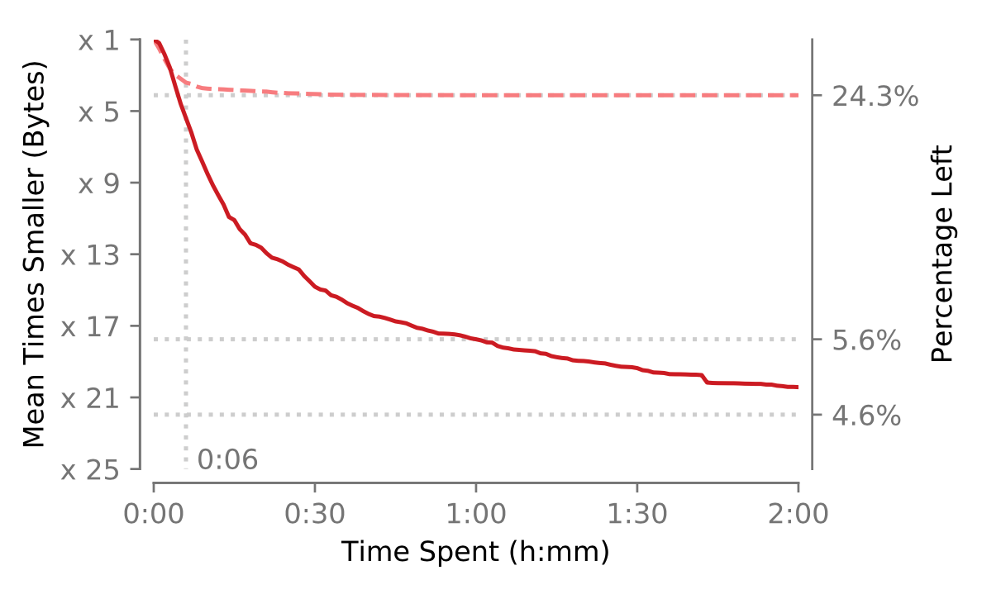
[1]

Slide 24
Class-based [1]
[1] Kalhauge, Christian Gram, and Jens Palsberg. "Binary reduction of dependency graphs." Proceedings of the 2019 27th ACM Joint Meeting on European Software Engineering Conference and Symposium on the Foundations of Software Engineering. 2019.
[2] Kalhauge, Christian Gram, and Jens Palsberg. "Logical bytecode reduction." Proceedings of the 42nd ACM SIGPLAN International Conference on Programming Language Design and Implementation. 2021.

Slide 25
Class-based [1]
Fine-grained [2]
[1] Kalhauge, Christian Gram, and Jens Palsberg. "Binary reduction of dependency graphs." Proceedings of the 2019 27th ACM Joint Meeting on European Software Engineering Conference and Symposium on the Foundations of Software Engineering. 2019.
[2] Kalhauge, Christian Gram, and Jens Palsberg. "Logical bytecode reduction." Proceedings of the 42nd ACM SIGPLAN International Conference on Programming Language Design and Implementation. 2021.

Slide 26
Class-based [1]
Fine-grained [2]
[1] Kalhauge, Christian Gram, and Jens Palsberg. "Binary reduction of dependency graphs." Proceedings of the 2019 27th ACM Joint Meeting on European Software Engineering Conference and Symposium on the Foundations of Software Engineering. 2019.
[2] Kalhauge, Christian Gram, and Jens Palsberg. "Logical bytecode reduction." Proceedings of the 42nd ACM SIGPLAN International Conference on Programming Language Design and Implementation. 2021.

Slide 27
Class-based [1]
Fine-grained [2]
10:00
[1] Kalhauge, Christian Gram, and Jens Palsberg. "Binary reduction of dependency graphs." Proceedings of the 2019 27th ACM Joint Meeting on European Software Engineering Conference and Symposium on the Foundations of Software Engineering. 2019.
[2] Kalhauge, Christian Gram, and Jens Palsberg. "Logical bytecode reduction." Proceedings of the 42nd ACM SIGPLAN International Conference on Programming Language Design and Implementation. 2021.

Slide 28
Class-based [1]
Fine-grained [2]
x 22
10:00
[1] Kalhauge, Christian Gram, and Jens Palsberg. "Binary reduction of dependency graphs." Proceedings of the 2019 27th ACM Joint Meeting on European Software Engineering Conference and Symposium on the Foundations of Software Engineering. 2019.
[2] Kalhauge, Christian Gram, and Jens Palsberg. "Logical bytecode reduction." Proceedings of the 42nd ACM SIGPLAN International Conference on Programming Language Design and Implementation. 2021.

Slide 29
Class-based [1]
Fine-grained [2]
x5.3
x 22
10:00
[1] Kalhauge, Christian Gram, and Jens Palsberg. "Binary reduction of dependency graphs." Proceedings of the 2019 27th ACM Joint Meeting on European Software Engineering Conference and Symposium on the Foundations of Software Engineering. 2019.
[2] Kalhauge, Christian Gram, and Jens Palsberg. "Logical bytecode reduction." Proceedings of the 42nd ACM SIGPLAN International Conference on Programming Language Design and Implementation. 2021.

Slide 30
Why: Static analysis is neither sound nor complete and dynamic debloating is slow.
What: Combining dynamic runs with static information is 5x better and 12x faster.
How: Binary reduction with logical dependencies.
Dynamic Debloating with JReduce

Slide 31
Why: Static analysis is neither sound nor complete and dynamic debloating is slow.
What: Combining dynamic runs with static information is 5x better and 12x faster.
How: Binary reduction with logical dependencies.
Dynamic Debloating with JReduce

Slide 32
Input
reduce( Input, φ )
Ipt
class A {
String m() {
return /* ✓ */;
}
}
class A implements I {
String m() {
return /* ✓ */;
}
}
¬[A ◁ I]
¬[A.m()].
class A implements I {
}
¬[A.m()!code]
class A implements I {
String m() {
return null;
}
}
11 kinds of variables

Slide 33
reduce( Input, φ )
class A implements I {
String m() { /* ✓ */ }
B n() { ... }
}
class B implements I {
String m() { ... }
B n() { ... }
}
interface I {
String m();
B n();
}
[A] [A◁I] [A:m()] [A:m()!code] [A:n()] [A:n()!code]
class A implements I {
String m() { /* ✓ */ }
B n() { ... }
}
class B implements I {
String m() { ... }
B n() { ... }
}
interface I {
String m();
B n();
}
[B] [B◁I]
[B:m()] [B:m()!code]
[B:n()] [B:n()!code]
[I]
[I:m()]
[I:n()]
[M] [M:x()] [M:x()!code] [M:main()] [M:main()!code]
class M {
String x(I a) { return a.m(); /* ✓ */ }
String main() { return new M().x(new A()); /* ✓ */ }
}

Slide 34
reduce( Input, φ )
class A implements I {
String m() { /* ✓ */ }
B n() { ... }
}
class B implements I {
String m() { ... }
B n() { ... }
}
interface I {
String m();
B n();
}
[A] [A◁I] [A:m()] [A:m()!code] [A:n()] [A:n()!code]
class A implements I {
String m() { /* ✓ */ }
B n() { ... }
}
class B implements I {
String m() { ... }
B n() { ... }
}
interface I {
String m();
B n();
}
[B] [B◁I]
[B:m()] [B:m()!code]
[B:n()] [B:n()!code]
[I]
[I:m()]
[I:n()]
[M] [M:x()] [M:x()!code] [M:main()] [M:main()!code]
class M {
String x(I a) { return a.m(); /* ✓ */ }
String main() { return new M().x(new A()); /* ✓ */ }
}

Slide 35
1,048,576
subprograms
0,006,766
valid

Slide 36
Syntactic Dependencies
[A.m()!code] ⇒ [A.m()]
[A ◁ I] ⇒ [A]
[A.m()] ⇒ [A]
class A implements I {
String m() { ... }
}
interface I {
String m();
}
[A]
[I]
[I.m()] ⇒ [I]
[A.m()]
[A ◁ I]
[I.m()]
Referential Dependencies
[A.m()!code]
[A ◁ I] ⇒ [I]

Slide 37
class A implements I {
String m() { ... }
}
interface I {
String m();
}
class A implements I {
String m() { ... }
}
interface I {
String m();
}
class A implements I {
String m() { ... }
}
interface I {
String m();
}
[I.m()] ⇒ [A.m()]
TO LOGIC
[A ◁ I] ∧ [I.m()] ⇒ [A.m()]
[A ◁ I] ⇒ [A.m()]

Slide 38
(syntax)
(files, lines) Items
Trees
Graphs
Logic
≤
≤
x ∧ y ⇒ z ∨ w
z ⇒ y
w ⇒ x ∨ y
(ddmin)
(hdd)
, (perses)
(Old J-Reduce)
(New J-Reduce)

Slide 39
1,048,576
subprograms
Binary Reduction
0,006,766
valid
0,000,011
tries

Slide 40
Why: Static analysis is neither sound nor complete and dynamic debloating is slow.
What: Combining dynamic runs with static information is 5x better and 12x faster.
How: Binary reduction with logical dependencies.
Dynamic Debloating with JReduce

Slide 41
Why: Static analysis is neither sound nor complete and dynamic debloating is slow.
What: Combining dynamic runs with static information is 5x better and 12x faster.
How: Binary reduction with logical dependencies.
Dynamic Debloating with JReduce

Slide 42
Dynamic Debloating
with JReduce
jdebloat/jreduce
jdebloat/jdebloat

