Slide 1
SSSS’21 Confine Tutorial
Multi-phase System Call Filtering for Container Attack Surface Reduction
Seyedhamed Ghavamnia, Tapti Palit, Michalis Polychronakis

Slide 2
Containers
Containers package software code and all its dependencies
Simplify the task of launching instances of the same application
Simplify continuous integration and continuous delivery (CI/CD) pipelines
Confine: Multi-phase System Call Filtering
for Container Attack Surface Reduction

Slide 3
OS Virtualization
Containers work based on OS virtualization (vs. HW virtualization)
Interest in containers has increased
Higher resource utilization
Easier to launch and maintain
Faster startup time
Better for software packaging
Confine: Multi-phase System Call Filtering
for Container Attack Surface Reduction

Slide 4
OS vs. HW Virtualization
OS Virtualization
HW Virtualization
VM1
VM2
Seccomp
App
App
App
App
App
Guest OS
Guest OS
Linux Kernel
Namespaces: Wraps a global system resource in an abstraction
Cgroups: Limits and accounts for the resource usage of processes
Capabilities: Divide privileges traditionally associated with superuser into distinct units
Isolation
Hypervisor
Isolation
Hardware
Hardware
Confine: Multi-phase System Call Filtering
for Container Attack Surface Reduction

Slide 5
OS vs. HW Virtualization
Container isolation enforced by kernel
Exploit kernel vulnerability = Break isolation
Possible strategies:
Use better isolation techniques (hardware, hypervisor, VMM)
Reduces resource utilization
Reduce kernel attack surface
Limit attacker capabilities required to break out of a container
Confine: Multi-phase System Call Filtering
for Container Attack Surface Reduction

Slide 6
Reduce Kernel Attack Surface
Linux kernel (v5.6) provides 349 system calls
Docker prohibits access to 44 system calls by default
Seccomp BPF filtering
Restrict access to system calls
Reduce the accessible parts of the kernel
Can we filter more system calls by analyzing the container?
Confine: Multi-phase System Call Filtering
for Container Attack Surface Reduction

Slide 7
Confine
Identifies system calls required through static and dynamic analysis
Generates a Seccomp profile for the whole container
New features (since SSSS ’20)
Consider a container’s different phases of execution
Generate a more restrictive filter based on the long-running application (app-specific)
Confine: Multi-phase System Call Filtering
for Container Attack Surface Reduction

Slide 8
Agenda
Overview
How to work with Confine
Demo:
Harden a sample Docker image
Escape container isolation by exploiting kernel vulnerability
Mitigate exploit by applying Seccomp profile created by Confine
Hands-on exercises
Confine: Multi-phase System Call Filtering
for Container Attack Surface Reduction

Slide 9
Confine Overview
Static Analysis
Launch
Monitor
Analyze
Docker Image
Container
List of Binaries & Libraries
Required Functions
Integrate
Libc -> Syscall
Dynamic Analysis
Required System Calls
Extract Direct Syscalls
Confine: Multi-phase System Call Filtering
for Container Attack Surface Reduction

Slide 10
Container-wide vs. App-specific Filters
List of Binaries & Libraries
Required
System Calls
find
rm
touch
mkdir
nginx
shm_get
getaffin
write
socket
getdents
execve
Confine: Multi-phase System Call Filtering
for Container Attack Surface Reduction

Slide 11
Container-wide vs. App-specific Filters
List of Binaries & Libraries
Required
System Calls
find
rm
touch
mkdir
nginx
shm_get
getaffin
write
socket
getdents
execve
Confine: Multi-phase System Call Filtering
for Container Attack Surface Reduction

Slide 12
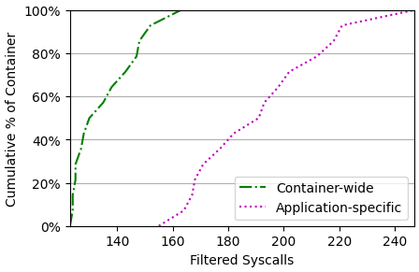
Container-wide vs. App-specific Filters
Confine: Multi-phase System Call Filtering
for Container Attack Surface Reduction

Slide 13
Confine Command Execution
Static Analysis
Launch
Monitor
Analyze
Docker Image
Container
List of Binaries & Libraries
Required Functions
Integrate
Libc -> Syscall
Dynamic Analysis
Required System Calls
How to run?
Extract Direct Syscalls
python3.8 confine.py -l libc-callgraphs/glibc.callgraph -m libc-callgraphs/musllibc.callgraph -i images.json -o output/ -p default.seccomp.json -r results/ -g go.syscalls/ --finegrain --othercfgfolder other-callgraphs.wsyscalls/
Confine: Multi-phase System Call Filtering
for Container Attack Surface Reduction

Slide 14
Confine Input
python3.8 confine.py -l libc-callgraphs/glibc.callgraph -m libc-callgraphs/musllibc.callgraph -i images.json -o output/ -p default.seccomp.json -r results/ -g go.syscalls/ --finegrain --othercfgfolder other-callgraphs.wsyscalls/
{"nginx": { "enable": "false", "image-name": "nginx", "image-url": "nginx", "options": "", "dependencies": {}, "binaries": ["nginx"], "docker-cmd": ["nginx","-g","daemon off;"], "entrypoint": "docker-entrypoint.sh", "docker-path": "/home/confine/nginx" } }
Confine: Multi-phase System Call Filtering
for Container Attack Surface Reduction

Slide 15
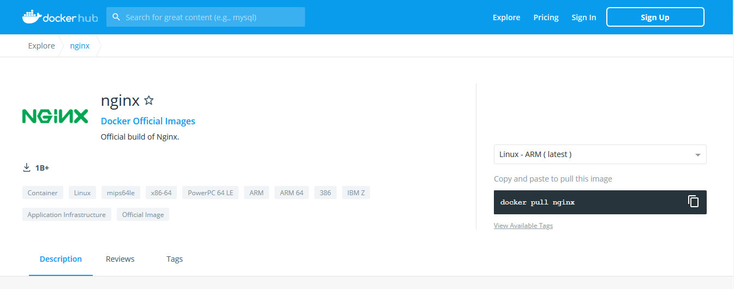
Docker Hub Example
Confine: Multi-phase System Call Filtering
for Container Attack Surface Reduction

Slide 16
Confine Input
python3.8 confine.py -l libc-callgraphs/glibc.callgraph -m libc-callgraphs/musllibc.callgraph -i images.json -o output/ -p default.seccomp.json -r results/ -g go.syscalls/ --finegrain --othercfgfolder other-callgraphs.wsyscalls/
{"nginx": { "enable": "false", "image-name": "nginx", "image-url": "nginx", "options": "", "dependencies": {}, "binaries": ["nginx"], "docker-cmd": ["nginx","-g","daemon off;"], "entrypoint": "docker-entrypoint.sh", "docker-path": "/home/confine/nginx" } }
Confine: Multi-phase System Call Filtering
for Container Attack Surface Reduction

Slide 17
Confine Input
python3.8 confine.py -l libc-callgraphs/glibc.callgraph -m libc-callgraphs/musllibc.callgraph -i images.json -o output/ -p default.seccomp.json -r results/ -g go.syscalls/ --finegrain --othercfgfolder other-callgraphs.wsyscalls/
Libc -> Syscall Mapping
Glibc: GCC RTL + egypt tool
Musl-libc: LLVM pass
Will not be performed today: it is provided in the repository
read
SYS_read
open
SYS_open
SYS_setreuid
setreuid
SYS_getrlimit
Confine: Multi-phase System Call Filtering
for Container Attack Surface Reduction

Slide 18
Agenda
Overview
How to work with Confine
Demo:
Harden a sample Docker image
Escape container isolation by exploiting a kernel vulnerability
Mitigate exploit by applying Seccomp profile created by Confine
Hands-on exercises
Confine: Multi-phase System Call Filtering
for Container Attack Surface Reduction

Slide 19
Demo
Harden a Docker image
Generate post-initialization filter
View generated Seccomp profile (both container-wide and app-specific)
View list of extracted binaries and libraries
View list of identified functions
Security benefit:
User level shellcode
Kernel vulnerability exploit
Confine: Multi-phase System Call Filtering
for Container Attack Surface Reduction

Slide 20
User level shellcode
Attacker wants to gain shell access in container
Exploits vulnerability in application running in container
Executes shellcode to get root shell in container
Confine filters system calls invoked through shellcode
Confine: Multi-phase System Call Filtering
for Container Attack Surface Reduction

Slide 21
Kernel Exploit - Threat Model
OS Virtualization
Seccomp
App
App
App
Linux Kernel
Namespaces: Wraps a global system resource in an abstraction
Cgroups: Limits and accounts for the resource usage of processes
Capabilities: Divide privileges traditionally associated with superuser into distinct units
Isolation
Hardware
Confine: Multi-phase System Call Filtering
for Container Attack Surface Reduction

Slide 22
Kernel Exploit - Threat Model
Attacker has root access to one container
Docker container processes are limited to 14 capabilities (out of >32)
SYS_ADMIN is not enabled
Required for installing module, reading kernel logs
Goal: Break out of container (perform operations not permitted in container)
Read kernel logs
Install kernel modules
Use vulnerability to add SYS_ADMIN capability to process
Confine: Multi-phase System Call Filtering
for Container Attack Surface Reduction

Slide 23
Kernel Exploit
CVE: 2017-5123: ability to write “non-controlled” user data to arbitrary kernel memory
Use vulnerability to overwrite capability flag of current process
Affected system call: waitid
User provides address for siginfo struct
Kernel fills that address with information from the process
Requires a check (missing in vulnerable version) on the provided address
Confine: Multi-phase System Call Filtering
for Container Attack Surface Reduction

Slide 24
SYSCALL_DEFINE5(waitid, int, which, pid_t, upid, struct siginfo __user *, infop, int, options, struct rusage __user *, ru){ struct waitid_info info = {.status = 0}; . user_access_begin(); unsafe_put_user(signo, &infop->si_signo, Efault); unsafe_put_user(0, &infop->si_errno, Efault); unsafe_put_user((short)info.cause, &infop->si_code, Efault); unsafe_put_user(info.pid, &infop->si_pid, Efault); unsafe_put_user(info.uid, &infop->si_uid, Efault); unsafe_put_user(info.status, &infop->si_status, Efault); user_access_end(); return err; }
typedef struct siginfo { int si_signo; int si_errno; int si_code; int padding; pid_t _pid; uid_t _uid; int _status; }
struct cred { . kernel_cap_t cap_inheritable; kernel_cap_t cap_permitted; kernel_cap_t cap_effective; kernel_cap_t cap_bset; . }
CAP_SYS_PTRACE
CAP_SYS_ADMIN
CAP_CHOWN
cap_effective[0]:
1 | 0 | ... | 1 | 0 | 0 | 0 | 1 | 0 | 0 | 1
0 | 1 | ... | 19 | 20 | 21 | 22 | 23 | .. | 30 | 31
typedef struct kernel_cap_struct { __u32 cap[2]; } kernel_cap_t;

Slide 25
Exploit Steps
Launch a container and run bash
Create a user with the highest possible UID (dummy)
Add user to sudoers
Switch to created user (dummy)
Run exploit which overwrites capabilities with UID
Confine: Multi-phase System Call Filtering
for Container Attack Surface Reduction

Slide 26
Agenda
Overview
How to work with Confine
Demo:
Harden a sample Docker image
Escape container isolation by exploiting kernel vulnerability
Mitigate exploit by applying Seccomp profile created by Confine
Hands-on exercises
Confine: Multi-phase System Call Filtering
for Container Attack Surface Reduction

Slide 27
Hands-on Exercise 1
Goal: Harden the Nginx Docker image
image-name: nginx
image-url: nginx
User guide: https://www3.cs.stonybrook.edu/~sghavamnia/confine/userguide.html
Step-by-Step Guide: https://www3.cs.stonybrook.edu/~sghavamnia/confine/stepbystep21.html
Confine: Multi-phase System Call Filtering
for Container Attack Surface Reduction

Slide 28
Hands-on Exercise 2
Goal: Test the functionality of the hardened container
Launch the container with the hardened profile
Hint: Use the commands in the user guide
Try fetching the default index file with: wget http://172.17.0.2
You might need to extract the IP first
Try connecting to the container and getting a shell
Did it work? (How about trying /bin/sh)
Run some commands. Is there anything that doesn’t work? (apt-get update)
Confine: Multi-phase System Call Filtering
for Container Attack Surface Reduction

Slide 29
Hands-on Exercise 3
Goal: Interpret results and identify security benefit
How many system calls can be filtered?
Map filtered system calls to CVEs
How? Refer to user guide (part 3)
How many CVEs are mitigated?
Was waitid() filtered? Do the results show CVE-2017-5123 being mitigated?
Confine: Multi-phase System Call Filtering
for Container Attack Surface Reduction

Slide 30
Thank you!
{sghavamnia, tpalit, mikepo}@cs.stonybrook.edu
Confine: Multi-phase System Call Filtering for Container Attack Surface Reduction
https://github.com/shamedgh/confine

Slide 31
Docker Default Capabilities
CHOWN
DAC_OVERRIDE
FSETID
FOWNER
MKNOD
NET_RAW
SETGID
SETUID
SETFCAP
SETPCAP
NET_BIND_SERVICE
SYS_CHROOT
KILL
AUDIT_WRITE
Confine: Multi-phase System Call Filtering
for Container Attack Surface Reduction

Slide 32
Glibc Callgraph
Glibc->Syscall Mapping
Compile glibc into RTL
Generate initial callgraph by running egypt tool on RTL
Map functions to system calls through parsing RTL
Handle weak aliases
Handle strong aliases
Handle versioned aliases
Handle compatibility symbols
Confine: Multi-phase System Call Filtering
for Container Attack Surface Reduction

