Slide 1
Software Fault Encouragement: Brittle Software Tutorial
Tristan Ravitch (tristan@galois.com)

Slide 2
Overview
A component of a defense-in-depth strategy for resilient control systems
Low overhead (0-5%)
No active monitoring
Supports legacy (binary only, no source required) systems
Turn attacks into hard-stop failures before attackers gain control
Supported Platforms
Linux/ELF (X86_64, PPC, ARM)
Implementation/Integration
Use the tools to automatically create binary variants
Modify or create an external watchdog
Minimal to no changes to the original control software
Notes:
TODO: Add a diagram

Slide 3
Brittle Software Concept

Slide 4
Concept
Brittle software crashes quickly under attack
Once attackers gain a foothold (via exploit), almost all security guarantees are lost
Crashing before an attacker gains control improves security
Alone, brittle software trades availability for confidentiality and integrity
Resilient systems have built-in redundancy and can recover from crashes, restoring availability
Notes:
TODO Add a diagram

Slide 5
Attack Model
The combination of artificial diversity and defensive transformations address:
Code injection attacks
Code reuse attacks (e.g., Return Oriented Programming)
Data-oriented attacks targeting the stack and heap
Notes:
Note that many modern platforms have hardware mitigations for code injection attacks (e.g., W^X); however, many legacy platforms and even newer microcontrollers do not.
Image source https://publicdomainvectors.org/en/free-clipart/Spy-behind-computer/68287.html

Slide 6
Attack Mitigations (1)
Code Injection Attacks
Code Reuse Attacks
Return-oriented programming
Jump-oriented programming
Mitigations
Code address randomization
Gadget disruption
Indirect branch guards
Notes:
Note: we do not really mitigate call-oriented programming attacks since we never move function entry points (more specifically, we redirect them)
Address randomization and gadget disruption break ROP attacks by changing the addresses that attackers rely on and by making gadgets less useful
Indirect branch guards restrict execution to ranges of known code to prevent code injection attacks

Slide 7
Attack Mitigations (2)
Data oriented attacks
Overwriting stack variables
Exploiting heap metadata (e.g., the poisoned NUL byte[1])
Mitigations
Stack frame offset randomization
Stack layout randomization
Heap randomization
[1] https://googleprojectzero.blogspot.com/2014/08/the-poisoned-nul-byte-2014-edition.html
Notes:
In contrast to the defenses that move code, these defenses move data to prevent attackers from knowing its static location and corrupting it

Slide 8
Properties of Brittle Software
As a cyber defense, the advantages of brittle software include:
Protection is passive
There is no active process for an attacker to bypass or subvert
Protection is a side effect of execution
Low-overhead
Supports legacy systems (no build system required)
Working at the binary level provides protections not possible at the source level

Slide 9
Related Work
Address-Space Layout Randomization
Software Fault Isolation
Active Execution Monitoring

Slide 10
Address Space Layout Randomization (ASLR)
Deployed uses of ASLR assign a unique address to each program module (executable and shared library) at load time
Difficult to guess in 64 bit address spaces
Compromised for the entire module with a single address leak
SFE:
More granular/higher entropy
Disclosure of one function address does not compromise others
Can be applied to legacy systems (no loader support required)
Each binary has a unique layout, but that layout does not change at load time

Slide 11
Software Fault Isolation (SFI)
SFI protects programs by placing components in (notionally) separate address spaces
Accesses to resources outside of those spaces cause fail-stop faults
SFE is a light-weight form of this for code:
If code outside of the expected executable region is about to execute, the program crashes
ROP-like executions can be disrupted
SFI: https://dl.acm.org/doi/10.1145/168619.168635
Notes:
SFI is a very heavyweight whole-program rewriting technique that isolates related collections of code and data, adding guards before every code and data access to ensure that it is within the same group. Transformations can allow almost arbitrarily-granular divisions. In the limit, this basically devolves to CFI (Control Flow Integrity)

Slide 12
Active Execution Monitoring
An execution monitor looks for deviations from expected execution traces:
Usually based on a collection of known-good observations or models
Requires the monitor to be cooperatively or pre-emptively scheduled
Stops execution if it deviates from expectation
SFE does not require a separate monitor
Less precise tracking of expected execution
No monitor to bypass/attack
e.g., https://galois.com/project/copilot/
Notes:
One can think of active monitors in this space as enforcers of control flow integrity

Slide 13
Limitations
Software brittleness is not a complete cyber-security solution by itself
It is part of a layered defense
There can be residual gadgets after diversification
Diversification is based on randomness and can have unpredictable performance impact

Slide 14
Brittle Software Workflow

Slide 15
Brittle Software Workflow
Identify Binary Artifact
Generate Binary Variants
Assurance
Tool: embrittle
Evaluate Residual Risk
Tool: visualization
Store and Start Multiple Variants
Adapt Watchdog
(Optional) Collect Crash Feedback
Notes:
Note that the exercise covers the entire workflow
The demos cover both tools in significant detail
The exercise also includes a demonstration of what a watchdog actually does
Note: Assurance will get its own section, but isn’t particularly addressed in the exercise

Slide 16
Identify Binary Artifact
Select binaries to diversify
Currently-supported binaries are:
X86_64
PowerPC (32 and 64 bit)
ARM (32 bit AArch32)
Linux ELF binaries (statically linked)
Good candidates include:
Externally-facing services (accessible directly or indirectly by a digital or analog adversary)
Components in an existing fault-tolerant environment
Statically-linked binaries

Slide 17
Generate Binary Variants
The primary interface is the embrittle tool, which generates binary variants

Slide 18
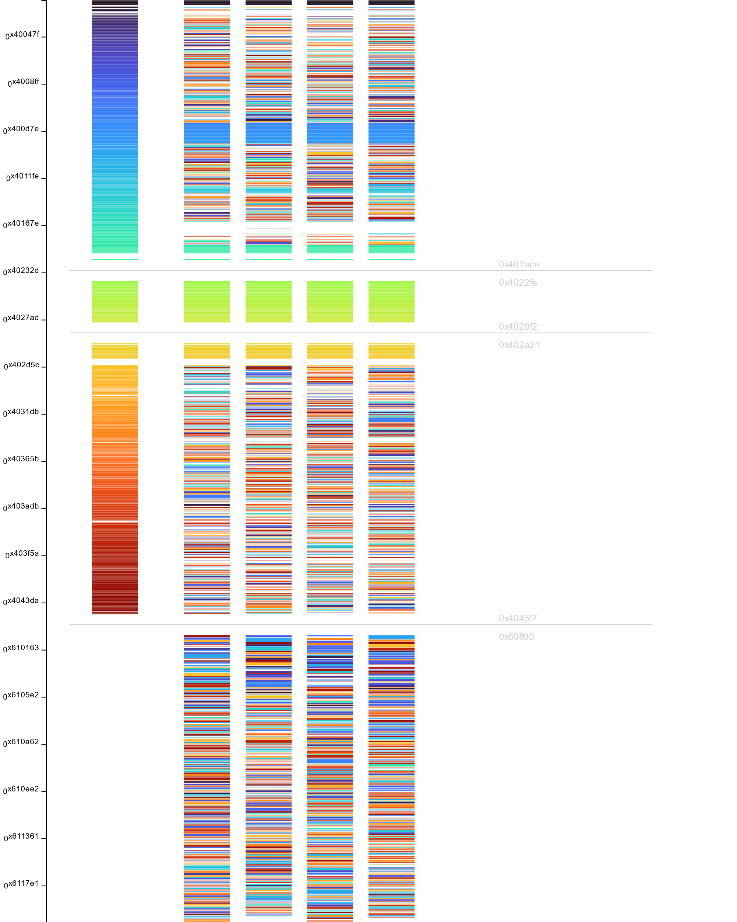
Evaluating Residual Attack Surface
Not all code can be moved
To evaluate residual gadgets, we have a visualization tool
Notes:
Note that there are gaps in the original binary. These include address space discontinuities and data interleaved with code, as well as simple padding
This view shows how basic blocks of code have been moved in the binary
Note that there is an extra section (actually, segment) of code that comes after the original to hold moved code, as the rewriting process requires some additional space

Slide 19
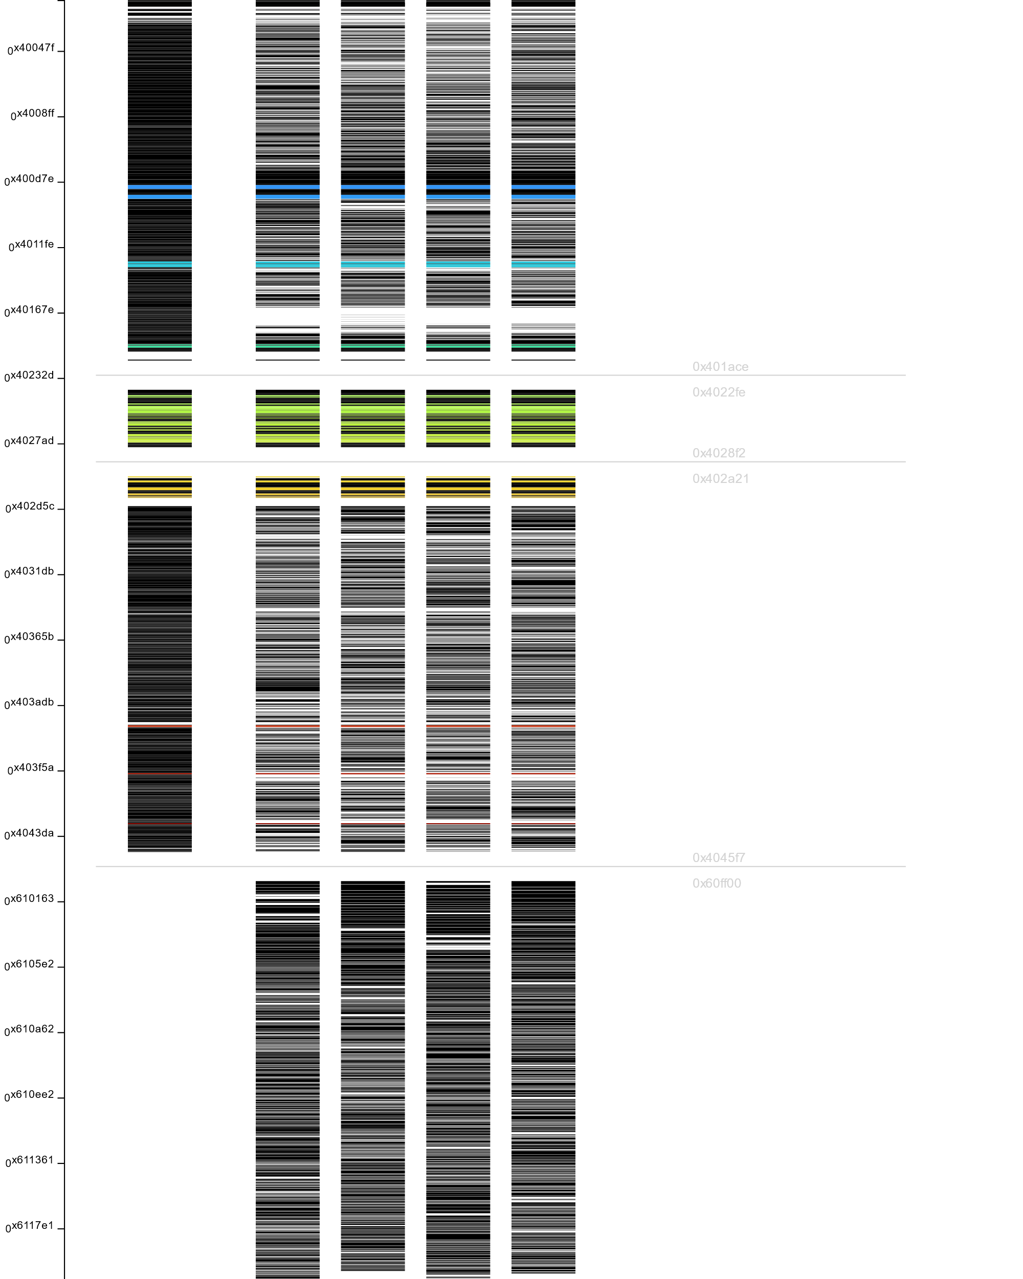
Evaluating Residual Attack Surface
Not all code can be moved
To evaluate residual gadgets, we have a visualization tool
Notes:
The visualization tool provides a mode to highlight only code that has not moved
This helps focus attack mitigation evaluation
There is a further refinement of this view that limits the view to gadgets that have not moved

Slide 20
Adapting the Execution Environment
The watchdog process must be updated to account for having multiple binary variants:
When (re-)starting the program, the watchdog should randomly select a variant
Manage I/O multiplexing
If the system supports hot spares with e.g., I/O redirection/copying, that mechanism may need to be variant-aware
Watchdog
Variant 1
Variant 2
I/O
Variant 3
Notes:
In this context, a watchdog process monitors the execution of another process and restarts it if it crashes
This dog is clearly keeping an eye on things
The watchdog must be made aware that multiple variants exist and it must mediate between the inputs and outputs of hot spares
The watchdog monitors multiple copies and initiates a recovery process if one crashes; it also ensures that I/O is managed in a safe way for the system. In this example, all variants get the same inputs but only one has its output connected to the real world at a time
There is an example of a watchdog and the integration effort in the exercise

Slide 21
Adapting the Execution Environment
Optionally, generated variants can report information about attacks
The watchdog process can be adapted to take advantage of this information
Reporting is currently handled via shared memory
Allows the watchdog to distinguish between transient faults and attacks
Watchdog
Variant 1
Variant 2
Variant 3
Notes:
Further, the Software Fault Encouragement tools provide a mechanism to allow the watchdog to detect determined attacks vs transient faults
The watchdog must be adapted to take advantage of this most effectively
Potentially, the feature could be used with post-hoc analysis of core dumps, if available
In a Linux environment, shared memory makes sense. In a more microcontroller-oriented environment, direct use of I/O pins may be more sensible. The tools are designed to work via memory-mapped I/O, which can in principle support either

Slide 22
Assurance
Correctness
Binary rewriting is difficult
We use a conservative strategy to avoid introducing bugs
We have also explored formal verification techniques
The embrittle tool provides a mode to attempt to prove functional equivalence between the original and diversified binaries
It is currently best-effort and the subject of ongoing work
Performance
embrittle avoids functional changes (except for obviously incorrect behavior)
The impact of timing changes is difficult to quantify automatically
Typically evaluated empirically
Varies between variants
Timing changes are the result of changing caching behavior by rearranging code
Notes:
Assurance in this case is gaining confidence that the tools do not break the target system
We want the transformed binaries to have the same behavior (under benign inputs)
We have a demonstration of automated verification of equivalence
There is guidance in later slides about the types of workloads amenable to the brittle software approach from a performance perspective

Slide 23
Implementation Guidance
Use cases and best practices

Slide 24
Suitable Targets
Static Linux (ELF) binaries
Supported architectures
X86_64
PowerPC (32 and 64 bit)
ARM (32 bit)
Source is not required
But can be helpful for integration
ARM limitations:
PIC is not yet supported
Thumb is not yet supported
Notes:
We have all of the decoders and semantics for Thumb, but have not hooked it up yet
It seems like PIC code would be easier to rewrite since all code is intended to be position-independent; however, the difficulty is in tracking the propagation of IP values that might need to be updated, especially when they become IP-relative data accesses
Static binary discussion is in a few slides

Slide 25
Discussion of Static Binaries
Our tools focus on supporting static binaries (i.e., not using shared libraries)
Shared libraries allow return-to-libc attacks
Static binaries can be entirely diversified
In a Capture the Flag (CTF) [1] event, dynamically-linked binaries were compromised in minutes
[1] https://www.hackthemachine.ai/ (2019)

Slide 26
Workloads and Performance
Binary rewriting can introduce performance regressions
Usually Safe Workloads
I/O-bound applications
Reactive systems
Sometimes Problematic Workloads
CPU-bound applications
Data processing applications where attackers control the amount of input data
CPU-bound applications can compound overhead in tight execution loops
Notes:
The primary concern here is that binary rewriting can perturb code layouts in a way that has a negative impact on performance
The problems arise due to changing cache behavior, which is not really practical to predict statically
In highly performance tuned systems, this could be a problem
However, most systems are not tuned to that level of cache control
In some cases, performance improves due to fortuitous cache changes
It seems like most control systems aren’t that performance sensitive and have enough headroom
Reactive and I/O bound systems will not have problems
Computationally-bound systems are a bit trickier

Slide 27
Performance Impact
The diversification tool moves code around randomly
This can lose some locality introduced by the compiler
Typical overheads are 0-5%
Overheads are negligible in code that is not in a CPU-bound tight loop
Most control systems seem to not be problematic since they have to respect deadlines
Key Takeaway: for timing-sensitive applications, testing binary variants is an important step

Slide 28
Variant Management
SFE generates randomized variants of binaries: management can be challenging
Typical scenarios involve:
Offline generation of variants in batches (generation can be expensive)
Random seeds can be saved to deterministically reproduce binaries (for auditability)
Could be thought of as a provenance tracking problem
Ensuring that the set of variants is the intended set
Detecting compromises
Ensuring consistency across a fleet of devices
Possible provenance tracking solutions from the DARPA ARCOS program
Tools for tracking cryptographic signatures over artifacts over time
Theoretical safety results
Notes:
SFE involves creating multiple (randomized) variants of the original program
Managing those variants poses extra challenges
We do not have experience with this at scale

Slide 29
Roadmap

Slide 30
Future Directions
Additional work in automated assurance
Support for other architectures (MIPS, RISC-V)
Addressing residual gadgets
More precise code discovery
More aggressive rewriting of indirect jumps
More mitigations for larger classes of attacks
Automating quantification of timing impact
Extended gadget disruption (e.g., via synthesis)
More detailed attack reporting
Fault localization
User-guided diversification
Notes:
These are ideas we have, but we are very open to hearing about use cases people have

Slide 31
Summary

Slide 32
Brittle Software Summary
Component of a defense-in-depth strategy
Low-overhead (0-5%)
No active monitor
Enhances resilient systems
Can disrupt a number of attacks
ROP
Code injection
Data-oriented attacks
Supported platforms:
Linux/ELF (X86_64, PPC, ARM)

Slide 33
Brittle Software Demo
Tristan Ravitch (tristan@galois.com)

Slide 34
Tools
Included in the Docker container:
embrittle (diversification tool)
visualize (residual attack surface analysis)
readelf (ELF file analysis)
objdump (disassembler)
gdb
Useful command invocations:
readelf –aW <binary>
Examine binary structure
objdump –d <binary>
Examine machine code
Notes:
The embrittle and visualization tools are the primary interface to Software Fault Encouragement
The other utilities are included in a typical Linux system and are useful for examining binaries
Note that these demos are included with the VM image for reproduction, along with the exercise

Slide 35
Demo 1: cmdline.exe
The program has an out-of-bounds array access
Vulnerable to an information disclosure vulnerability
Demonstrates:
Variant generation
Layout strategies
Visualization of residual attack surface
Memory attack mitigation
Notes:
The program has an out-of-bounds array access
A “clever” attacker can provide command line arguments to disclose a secret stored on the stack
Note that the variant generation process can save random seeds to let us reproduce random variants exactly for auditing and debug purposes
The data attack mitigations cause the program to crash instead of exposing its secrets

Slide 36
Demo 2: rop-target.exe
This program is vulnerable to a ROP attack
The demo includes an example ROP attack to run against it: rop.py
The rop.py script can launch the attack against the original binary and variants
Demonstrates:
ROP mitigation
Variant generation
Notes:
The ROP attack is executed by a script (since it involves writing binary data that is difficult to do by hand interactively)
The original program just exits cleanly
The attack takes control of the program and executes the ls command (via /bin/sh) and then exits
The attack was generated mostly automatically using the ROPGadget tool (https://github.com/JonathanSalwan/ROPgadget)
Note that the target program has a few gadgets injected into it – the compiler did not generate enough to easily pull off the attack (see gadgets.s)
The script to launch the attack has a bit of logic in it to flush stdin at the right times to actually make the attack progress and not just be completely buffered
ROP attack notes:
The syscall number for execve is 59 (hence the repeated add1 calls)
This includes the argument for exec: /bin/sh
The padding bytes position the payload to overwrite the return address of the caller of gets on the stack (so that, on return from gets, the attack begins)

Slide 37
Brittle Software Exercise
Tristan Ravitch (tristan@galois.com)

Slide 38
Exercise Description
The exercise is to modify an existing control system (with included watchdog process) to take advantage of software brittleness
Exploit the demonstration system
Generate diverse variants using embrittle
Adapt the watchdog to use them
Attempt the exploit again
Adapt the watchdog to restart variants from the pool
Implement attack detection in the watchdog

Slide 39
Getting Started
Connect to the VM instance
Start the container in a terminal: docker run –p 5000:5000 –-rm –it software-fault-encouragement
Start Visual Studio Code from the Applications -> Development menu
Attach to the container from VS Code by clicking on the icon in the very lower-left corner and then selecting “Remote Containers: Attach to Running Container” from the quick menu

Slide 40
Tools
Included in the Docker container:
embrittle (diversification tool)
visualize (residual attack surface analysis)
readelf (ELF file analysis)
objdump (disassembler)
gdb
Useful command invocations:
readelf –aW <binary>
Examine binary structure
objdump –d <binary>
Examine machine code
Notes:
The embrittle and visualization tools are the primary interface to Software Fault Encouragement
The other utilities are included in a typical Linux system and are useful for examining binaries

Slide 41
Technical Details

Slide 42
Design Goals
Low overhead (space and time)
Works on binaries
Resilient to incomplete program knowledge
Minimal impact to machine code (for debugging and understandability)
Notes:
We aim for resilience w.r.t. incomplete program knowledge because binary analysis is inherently undecidable and approaches are either incomplete or have massive over-approximations
We aim for safe incompleteness, because the alternative is typically highly-disruptive
While we are rewriting binaries, we want the results to look as similar as possible to the originals so that they can be audited and understood
Some approaches e.g., lift to LLVM, transform, and then recompile. This can in principle have good results, but:
It is very difficult to lift reliably from machine code to LLVM as machine code has many incidental dependencies that are not reflected in higher level programs (like the source or LLVM), and recovering them in a way that is agnostic to the difference is really challenging
Generated code from LLVM will have no relation to the original binary

Slide 43
Approach
We use binary rewriting to 1) move code randomly within a binary, and 2) add protections against a selection of attacks
Lift binaries to an intermediate representation for analysis
Rewrite at the machine instruction level to preserve connection to the original binary
Update symbol information (if present) to aid debugging
Lift
IR
Code Discovery
Functions/Blocks
Rewriting
(Randomness + Mitigations)
Variants
Notes:
This is in contrast to other approaches that attempt to lift to LLVM and recompile to machine code: those approaches significantly inflate code size and give up significant performance while introducing complexity

Slide 44
Binary Rewriting Challenges
Binary rewriting presents a number of challenges:
Moving anything changes every offset
Constraints imposed by the Linux kernel restrict layout options
Addresses* stored in the data section are difficult to update
Addresses often look similar to floating point values
Notes:
No knowledge of machine code is expected here
The first highlight shows an indirect call (through a function pointer)
The value is dynamically-updated so we don’t know what it will be
It is likely initialized with some value in the data section
We cannot guarantee (without expensive and likely intractable global analysis) that the values that flow to that address are only function pointers that could be updated
Updating all values in the data section that look like function pointers could break the program by e.g., modifying floating point values
In the limit, we could even miss function pointer values that are created in clever ways, also breaking the program
To avoid that, we do not move function entry points (ever)
The second highlight shows that most control flow is relative
Moving the target of the jump requires updating this offset
Moving this code also requires changing the offset

Slide 45
Binary Rewriting Constraints
.text
Jump range limitations (especially PowerPC and ARM)
Kernel alignment requirements
Kernel segment ordering restrictions
.extratext
Notes:
PowerPC and ARM have limited capacity for local jumps
Reduces the range we can easily handle without tricks (and lost efficiency)
Longer jumps are easily accomplished by storing addresses or larger offsets in memory and using indirect jumps
Kernel alignment requirements mean that we can’t necessarily move the original code without blowing up the binary size
Restrictions on segment orders/placement restrict where new code can be placed

Slide 46
Safe* Binary Rewriting
.text
.text
Redirect execution from original code to new (diversified) code
Can be at the block or function level
Re-use space from redirected code
Place extra code in an extra segment
Cannot rewrite:
“Incomplete” functions
Indirect jumps
Overlapping functions
func1
func2
func1'
func3'
func3
.extratext
func2'
Notes:
There are still some assumptions made by this strategy
All variants of “no jumps into the middle of other functions from undiscovered code”

Slide 47
Different Code Layout Strategies
Code Layout Granularity:
Shuffle functions
Shuffle blocks
Shuffle blocks, but keep loop bodies together
Preserves locality while maximizing randomness
Space Reuse:
Reuse space in the original text section
Benefit: more compact binaries
Fill the original code space with halt instructions
Benefit: easier attack detection
Notes:
Basic blocks are sequences of machine instructions with no control flow transfers

Slide 48
Implementation
Largely open source
https://github.com/travitch/dismantle (disassembly)
https://github.com/GaloisInc/flexdis86 (disassembly)
https://github.com/GaloisInc/elf-edit (ELF parsing/editing)
https://github.com/GaloisInc/semmc (machine code semantics)
https://github.com/GaloisInc/macaw (machine code discovery)
https://github.com/GaloisInc/renovate (binary rewriting)
https://github.com/GaloisInc/crucible (verification)
Implemented in Haskell
Two components:
Binary diversification tool
Visualization
The visualization serves data via a web server
Distributable as a Docker container

Slide 49
Limitations
Not all code can be relocated:
Some limitations can be addressed with engineering (jump tables)
Others are inherent (undecidability of code discovery)
ROP only needs a small number of gadgets
There is no bulletproof mitigation, but we provide analysis tools to evaluate residual risk

