Slide 1
CBAT: A Comparative Binary Analysis Tool
Software Security Summer School
August 2020

Slide 2
Motivation

Slide 3
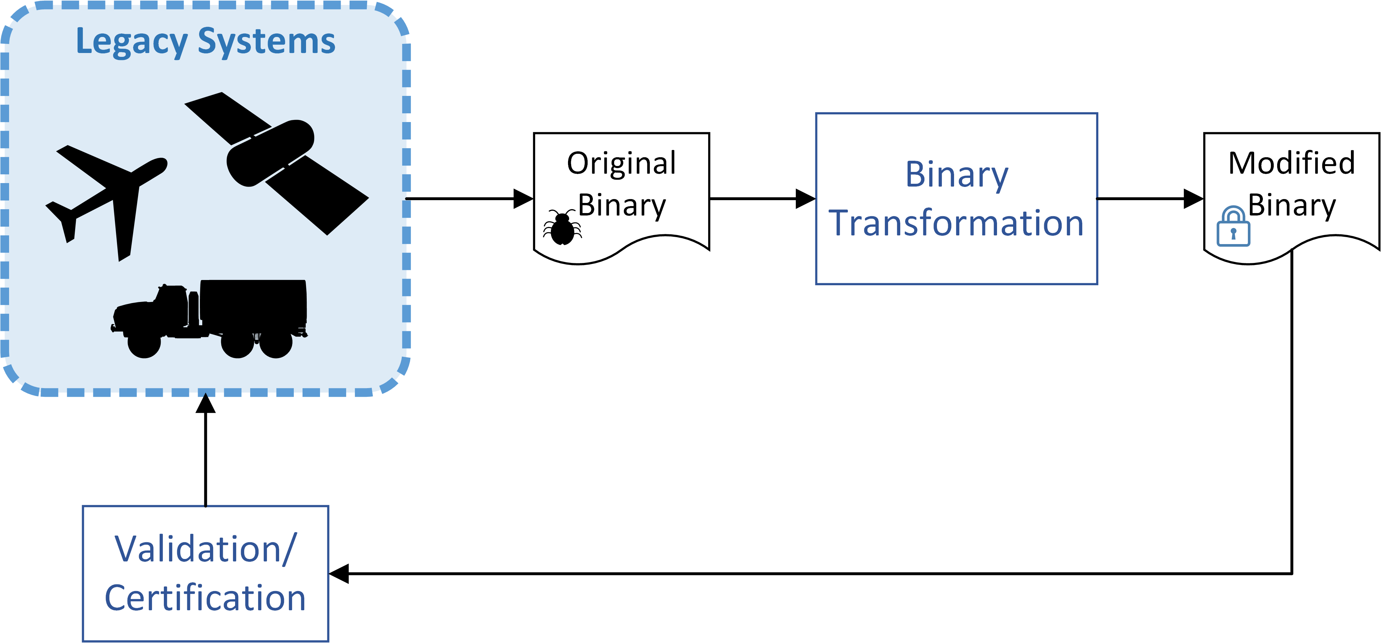
Motivation

Slide 4
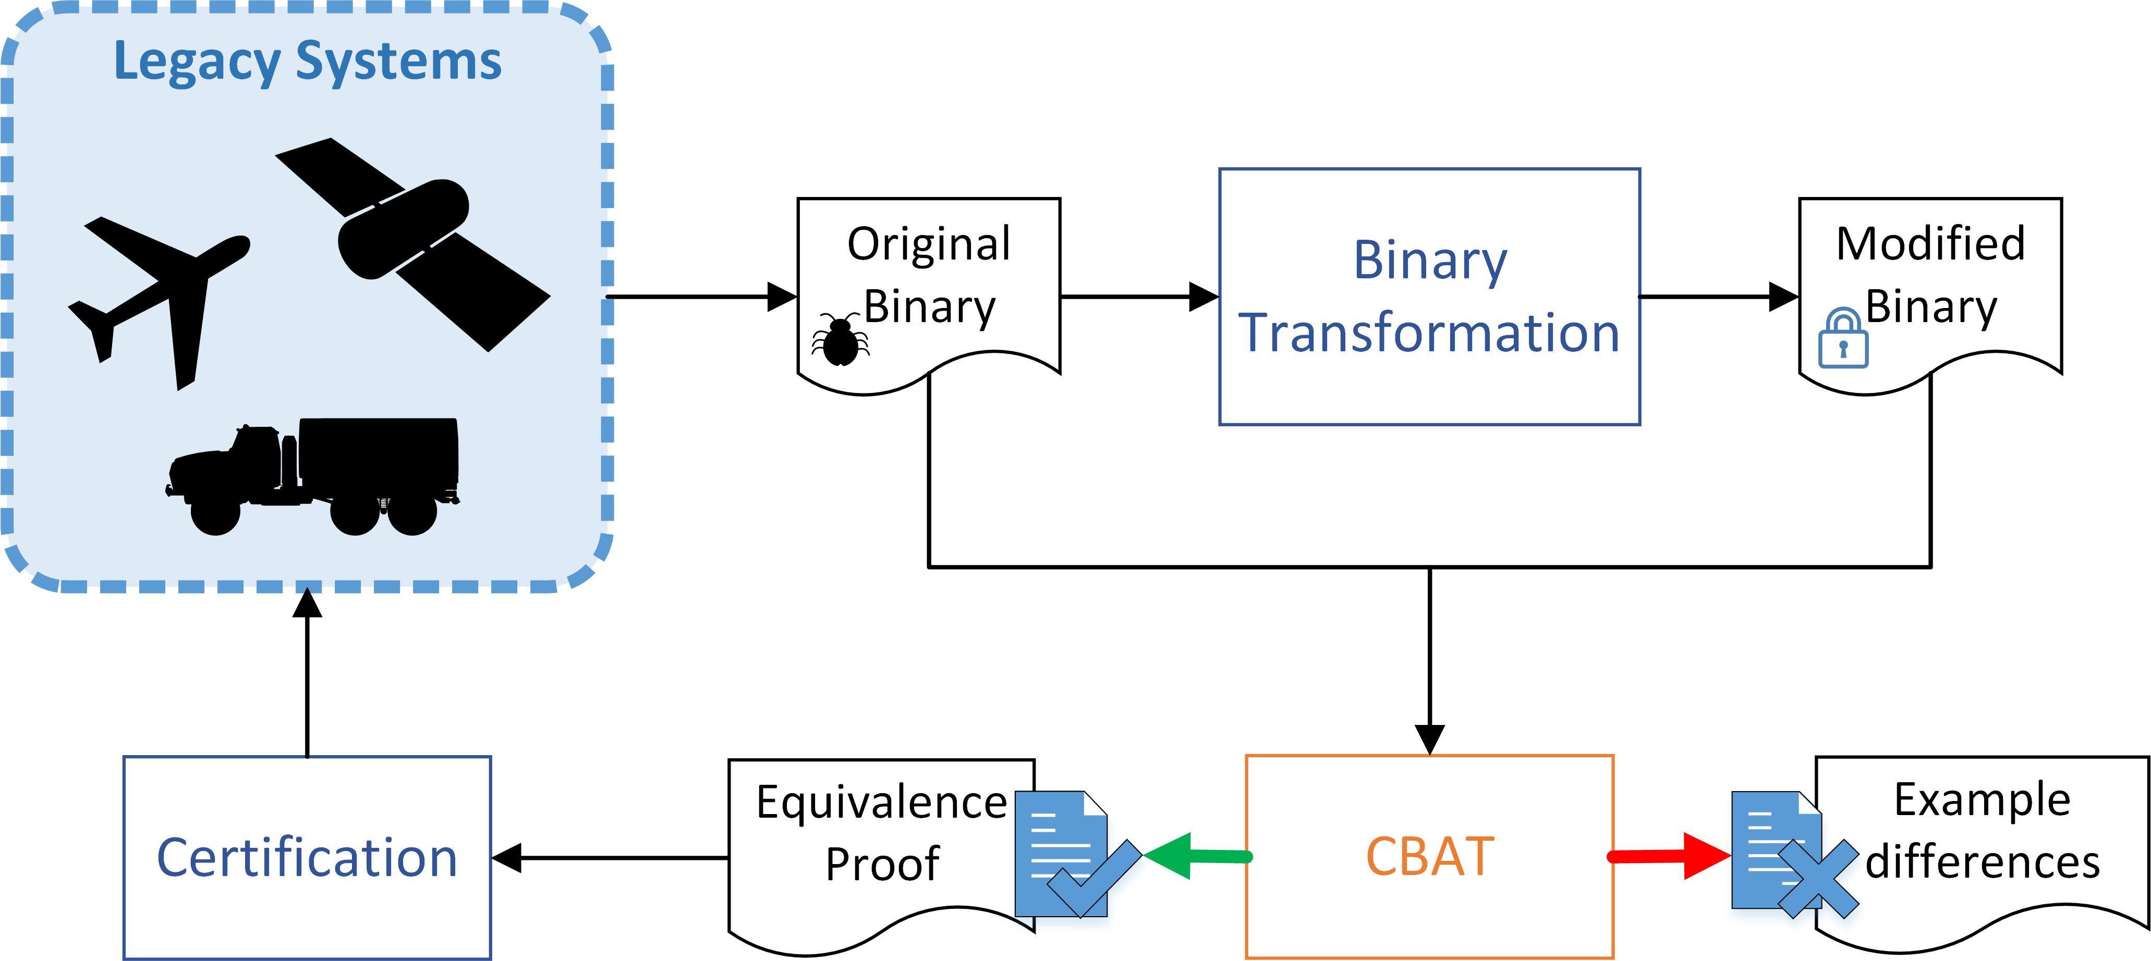
Motivation

Slide 5
Motivation
CBAT proves “relative correctness” of two programs or provides program inputs that demonstrate differences.

Slide 6
Key Idea 1: Binary Analysis Toolkits
Several open-source binary analysis toolkits are available.
Most resulted from the DARPA Cyber Grand Challenge.
Provide a starting point for new binary analysis tooling:
Decompilation from many binary formats to a platform-independent intermediate representation (IR).
Analysis frameworks for IR programs.
Draper evaluated two major toolkits (Angr and BAP).

Slide 7
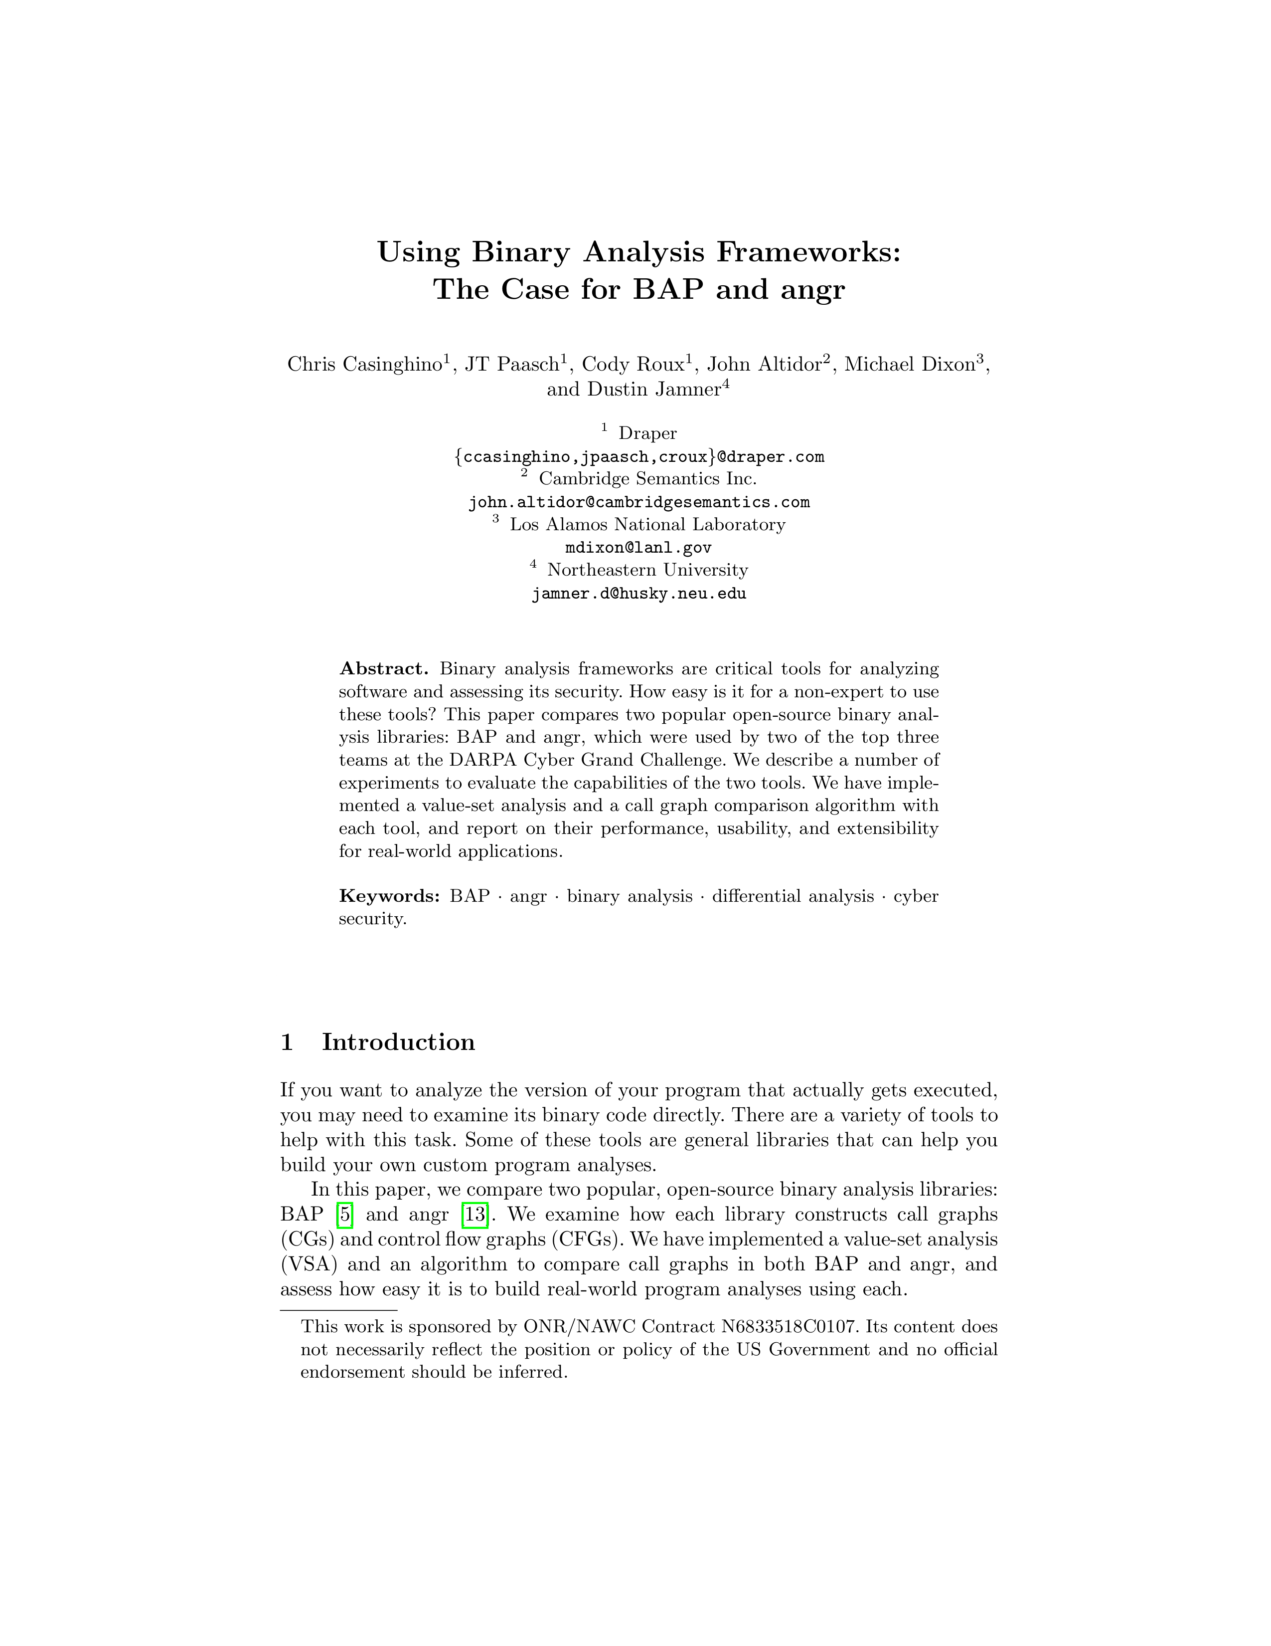
BAP/Angr User Study
High-level comparison of the two tools.
Published in NASA Formal Methods 2019
Based on this study, we selected BAP as the primary platform for CBAT.
More flexible.
Slightly more performant.
Better supported and documented.

Slide 8
Key Idea 2: Differential Program Analysis
Late-stage customization provides an opportunity for formal verification:
The original program can establish base truth about intended behavior.
CBAT builds on research in this space, called differential program analysis.
We extend and mature it.
We bring it to binary (previously mostly for source code)
Idea: generate relative verification conditions that may be easier to check.

Slide 9
Weakest Precondition (WP) Analysis
Single program analysis
Testing
Verification
Bug-finding
WP
Comparative analysis
Relative correctness proofs
Difference discovery

Slide 10
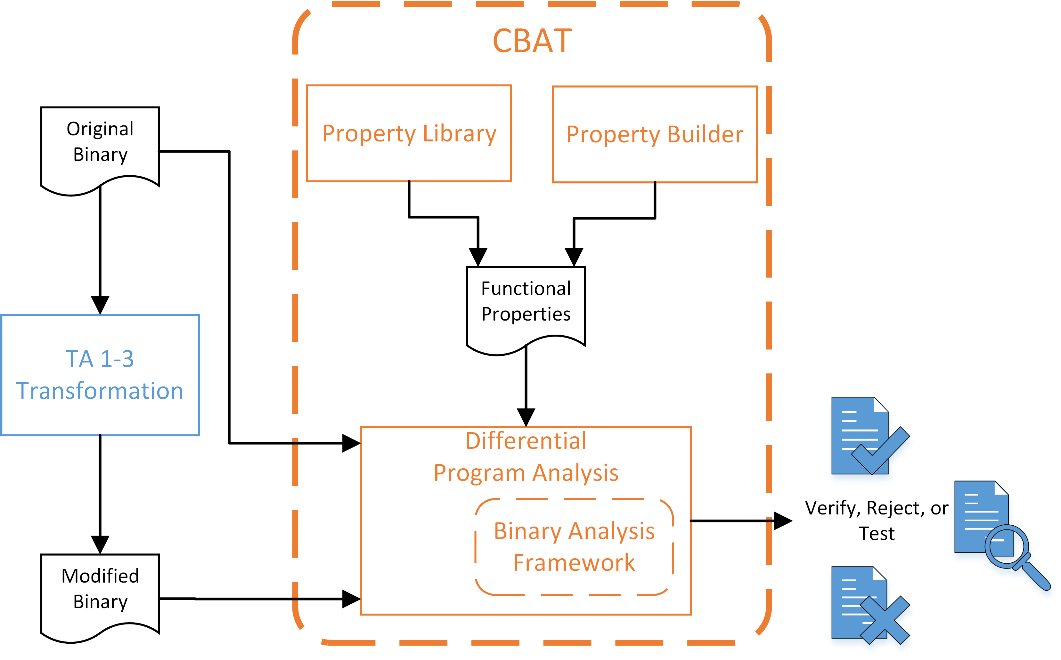
Putting it together

Slide 11
Availability
CBAT is free, open-source software:
MIT license makes reuse easy.
Thanks to ONR for supporting development and allowing us to release it.
Questions or comments after tutorial? Please reach out:
Chris Casinghino
ccasinghino@draper.com
https://github.com/draperlaboratory/cbat_tools

