Slide 1
RVFuzzer: Finding Input Validation Bugs in Robotic Vehicles through Control-Guided Testing ONR SSSS’20 (August 3, 2020) Gregory Briskin, Dongyan Xu, Taegyu Kim Intelligent Automation, Inc. (IAI), Purdue University,

Slide 2
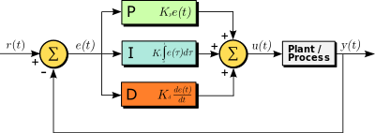
Robotic Aerial Vehicle Control
RAV Controller
Control vehicle movements & operations
Follow user commands
With many configurable parameters
Feedback Input
RAV System
Ground
Control
Station
Mission
Module
Sensor Module
$$z$$
Controller
$$yaw$$
Physical
Environment
$$pitch$$
$$y$$
Motor
$$x$$
$$roll$$
Aerodynamics
Notes:
Let me introduce what is the robotic aerial vehicle which we simply call RAV.
RAV system consists of controller, motor, mission and sensor modules.
It stabilizes the physical operations during the flight for all axes while executing user commands such as going to some destination.
Also, RAV supports configuration command to change parameters for troubleshooting or tuning controllers

Slide 3
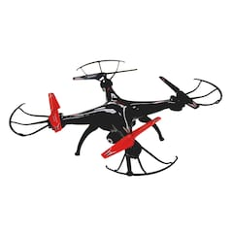
Attack Surface with Remote Input
$$yaw$$
$$pitch$$
$$y$$
$$x$$
$$roll$$
Controller
Param.
x-axis Cascading Controller
Ground Control Station (GCS)
POS
Controller
VEL
Controller
ACCEL
Controller
Physical
Operations
Mission
Param.
$$k_{x}$$
$${\dot{k}}_{x}$$
$${\ddot{k}}_{x}$$
Hundreds of
parameters
Dynamically
configurable
$$r_{x}$$
$${\dot{r}}_{x}$$
$${\ddot{r}}_{x}$$
$$o_{x}$$
$$x_{x}$$
$${\dot{x}}_{x}$$
$${\ddot{x}}_{x}$$
Sensor
+ Sensor Param.
Feedback Input
Notes:
So, here is 6DoF.
Each degree is controlled by one cascading controller.
As an example of an x-axis cascading controller, there are three cascaded primitive controllers.
The operations of controllers are determined by control parameters such as controller, mission, and sensor parameters.
Also, there are hundreds of such control parameters which are dynamically configurable by GCS.
However, such GCS control interface opens up the new security hole.

Slide 4
Landscape of RAV Attacks
Sensor spoofing
Physical attacks
Example: sensor spoofing
Defense: control-based detection and filtering
Software “syntactic” bug exploitation
Example: memory corruption
Defense: program fuzzing and hardening
Control-”semantic” bug exploitation
Less studied and addressed
Not defendable with approaches above
Notes:
Then, let me talk about security holes.
Before we talk about our new attack surface.
Let me summarize two existing attacks.
First one is a physical attack such as sensor spoofing.
For example, during the normal flight, if an attacker generates noise to mislead the sensor, it will disturb robotic vehicle’s physical operations.
This causes even severe injuries.
But, this can be mitigated by control-based detection or filter
The other one is a traditional bug exploitation.
Since a control program is a type of a program, it has inevitably software bugs such as buffer overflow.
Its exploitation can also lead to malfunctioning the controller.
We call this type of a bug as a “syntactic” bug
However, this type of attacks can be mitigated by program fuzzing or hardening.
(Slowdown)
In this work, we propose a 3rd type of a “semantic” bug instead of a “syntactic” bug.
We call this bug as control-semantic bug.
This is new and has not received much attention.
But, it is not defendable with above defense mechanisms.

Slide 5
Parameter Validation Bug
Exploitable via GCS commands
Exploiting lack of or inaccurate input parameter range check
Triggered by a malicious parameter-change command
Causing controllers to malfunction
Minimum footprint: one innocent-looking command, no sensor spoofing, no code injection, no code trojaning

Slide 6
Parameter Validation Bug
Attack launched
Normal flight
1
2
1
2
3
Brute force attacks
3
Parameter P
“Not-allowed” Range
“Not-allowed” Range
Squeezing into
Valid Input Range
Permitted Input Range

Slide 7
External Disturbance Effect
Normal flight
w/o strong wind
Attack
w/ strong wind
1
2
1
2
3
3
Parameter P
Notes:
Furthermore, wind can also affect the true valid range.
For example, suppose a value within the green range does not cause any physical disturbance.
But, wind effect can shrink the green range as you can see.
As a result, it leads to exposing additional invalid values.

Slide 8
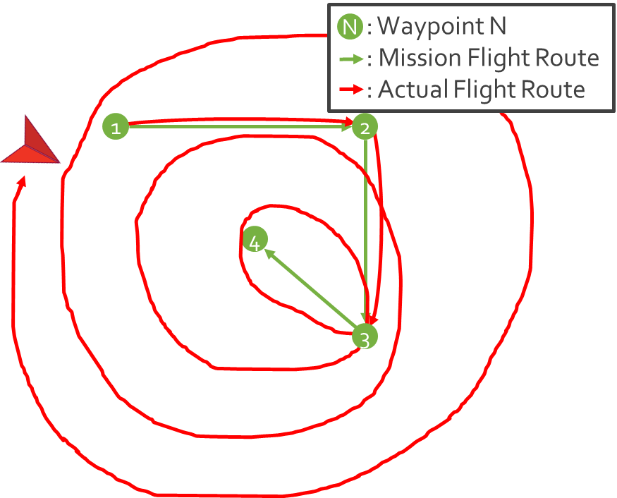
RVFuzzer: Challenges and Solutions
Challenge
Solution
How to detect a bad program run?
With traditional bugs
Crash
With control-semantic bugs
Various vehicle anomalies
Cannot afford real vehicle crashes
Define control instability condition
Based on standard control property and metrics
Unrecoverable discrepancy between
Reference and State
Reference and Mission
1
2
3
Notes:
On the other hand, RVFuzzer is designed to find configurable parameter bugs because there are many combinations which cause control instability. To perform fuzzing, there are two challenges.
How to determine bug exploitation like program crash or memory corruption in the program.
For this purpose, we consider control instability as the result of bug exploitation

Slide 9
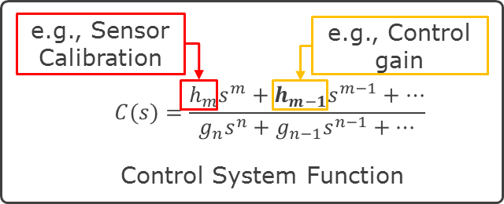
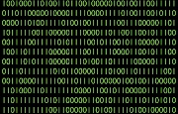
RVFuzzer: Challenges and Solutions
Challenge
Solution
Large input mutation space
Many parameters and factors
Blackbox (“binary program+Vehicle") testing
Efficient control program testing
Software-in-the-loop simulation
Feedback-directed
Leveraging control properties
Vehicle
Program
Environmental Factors
Notes:
Also, there are too many testing cases since control systems has multiple variables and complex inter-dependencies.
Furthermore, it is hard to extract their control system function. So, we consider control program as black box.
We perform efficient control-guided and feedback-directed testing.
In terms of control-guided, we found that as parameters are deviated from the normal values, they cause more instable controller states.
We use such observation as control-guide to reduce input space and feedback.

Slide 10
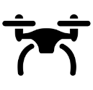
RVFuzzer Overview (USENIX Security’19)
Ground Control Station
(GCS) Software
Mutated parameter
input commands
Input commands
Binary
Control
Program
Sensor
inputs
Control state
outputs
Control-Guided Tester
Simulator
Control Instability
Detector
Bad program run detection
Motor
outputs
Control
states
$$f(s)$$
Control-Guided
Input Mutator
Safe
Fuzzing
Mutated wind configuration
Mutated
parameters
Efficient
Fuzzing
Notes:
Here is the overview.
There is a target control “binary” program.
Then, our target program interacts with the simulator by sending and receiving sensor inputs and motor outputs.
This enables us to safely perform control loop fuzzing.
Then, such control program is controlled by “real” GCS software.
This GCS sends control commands while receiving control states of the control program.
Then, we connect our control-guided tester to GCS.
Inside of our tester, there is a control instability detector to detect a bad program run by monitoring control states.
Depending on the detection results, control-guided input mutator mutates parameter inputs and wind configuration to improve testing efficiency.

Slide 11
Evaluation with ArduPilot and PX4: 89 Bugs Found
Module | Sub-module | ArduPilot |  | PX4
 |  | RIB | RSB | RIB | RSB
Controller | x, y-axis position | 1 | 0 | 1 | 1
 | z-axis velocity | 2 | 1 | 1 | 1
 | x, y-axis position | 1 | 0 | 1 | 1
 | z-axis velocity | 1 | 0 | 1 | 0
 | z-axis acceleration | 3 | 0 | 0 | 0
 | Roll angle | 1 | 0 | 1 | 1
 | Roll angular rate | 5 | 0 | 3 | 3
 | Pitch angle | 1 | 0 | 1 | 1
 | Pitch angular rate | 5 | 0 | 3 | 3
 | Yaw angle | 1 | 0 | 2 | 2
 | Yaw angular rate | 6 | 0 | 3 | 3
 | Motor | 0 | 0 | 3 | 3
Sensor | Inertia sensor | 3 | 3 | 0 | 0
Mission | x, y-axis velocity | 1 | 1 | 2 | 0
 | z-axis velocity | 2 | 0 | 4 | 0
 | z-axis acceleration | 2 | 0 | 0 | 0
 | Roll, pitch | 1 | 1 | 1 | 1
Total | - | 36 | 6 | 27 | 20
8-day run
89 bugs are found
8 confirmed by developers
7 patched by developers
RIB: Range Implementation Bug
RSB: Range Specification Bug
Notes:
As a result, we have found 89 vulnerabilities from different sub-modules of ArduPilot and PX4 control programs during our 8-days testing.
We note that both programs are known as the two most popular control programs.
Also, we tested open source programs only to obtain the ground truth but RVFuzzer does not require source codes.
Out of the bugs, 63 bugs are range implementation bug with incorrect range check implementation.
26 bugs are range specification bugs whose ranges are incorrectly specified in the document.
8 of them were confirmed and 7 of them were patched by developers.
We confirmed the effects of all of our findings.
And, developers are independently confirming the rest of reported bugs.

Slide 12
Evaluation: Vulnerable Parameters of ArduPilot
Control Program Module | Parameter | Physical Impacts
 |  | C | D | U | S
Controller | PSC_POSXY_P | ✓ |  |  | ✓
 | PSC_VELXY_P | ✓ | ✓ | ✓
 | PSC_VELXY_I |  | ✓ | ✓
 | PSC_POSZ_P |  |  |  | ✓
 | PSC_VELZ_P | ✓
 | PSC_ACCZ_P | ✓ |  |  | ✓
 | PSC_ACCZ_I | ✓ | ✓ | ✓
 | PSC_ACCZ_D | ✓ | ✓ | ✓
 | ATC_ANG_RLL_P | ✓
 | ATC_RAT_RLL_I | ✓
 | ATC_RAT_RLL_IMAX | ✓ |  |  | ✓
 | ATC_RAT_RLL_D | ✓
 | ATC_RAT_RLL_P | ✓ |  | ✓
 | ATC_RAT_RLL_FF | ✓ |  | ✓
 | ATC_ANG_PIT_P | ✓
 | ATC_RAT_PIT_P | ✓ |  | ✓
 | ATC_RAT_PIT_I | ✓
 | ATC_RAT_PIT_IMAX | ✓
Control Program Module | Parameter | Physical Impacts
 |  | C | D | U | S
Controller | ATC_RAT_PIT_D | ✓ |  |  | ✓
 | ATC_RAT_PIT_FF | ✓ |  | ✓ | ✓
 | ATC_ANG_YAW_P | ✓
 | ATC_SLEW_YAW |  |  | ✓
 | ATC_RAT_YAW_P |  |  | ✓
 | ATC_RAT_YAW_I |  |  | ✓
 | ATC_RAT_YAW_IMAX |  |  |  | ✓
 | ATC_RAT_YAW_D | ✓ |  |  | ✓
 | ATC_RAT_YAW_FF | ✓ |  | ✓
Sensor | INS_POS1_Z | ✓ |  | ✓
 | INS_POS2_Z | ✓ |  | ✓
 | INS_POS3_Z | ✓ |  | ✓
Mission | WPNAV_SPEED |  |  |  | ✓
 | WPNAV_SPEED_UP |  |  |  | ✓
 | WPNAV_SPEED_DN |  |  |  | ✓
 | WPNAV_ACCEL | ✓ |  |  | ✓
 | WPNAV_ACCEL_Z | ✓ |  |  | ✓
 | ANGLE_MAX | ✓ |  |  | ✓
C: Crash
D: Deviation
from trajectory
U: Unstable
movement
S: Stuck in
a certain location
Notes:
Also, we have found a lot of vulnerable parameters.
And this is a part of those parameters found from ArduPilot.
Depending on the value of each parameter, it shows different physical impacts such as crash or deviation from trajectory.

Slide 13
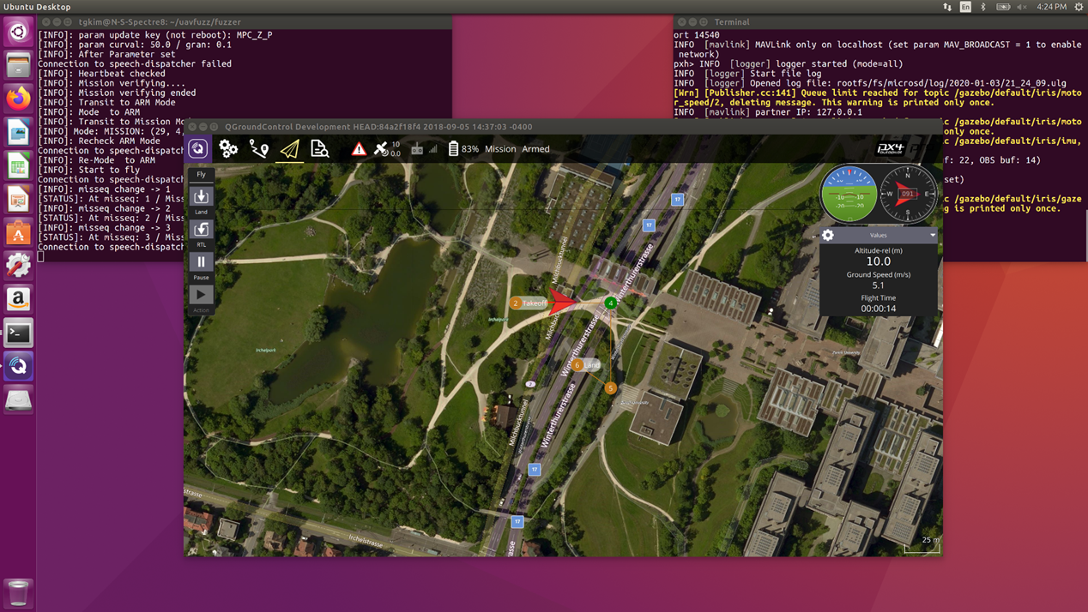
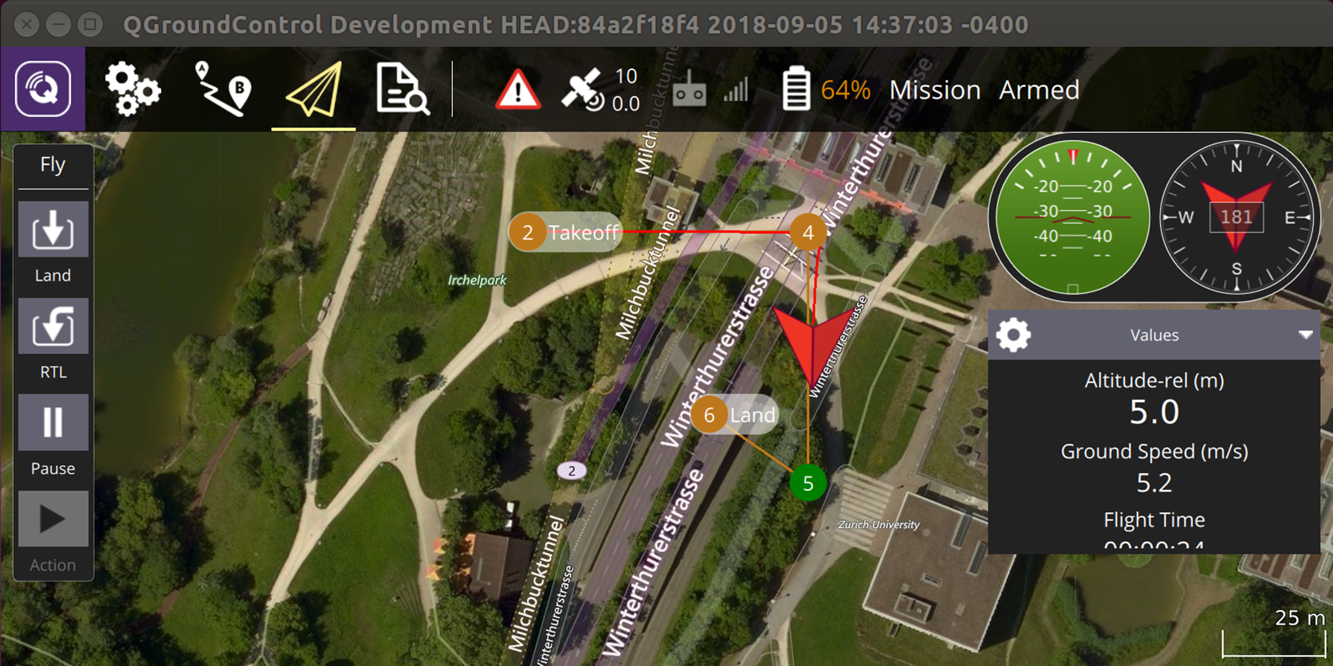
T&E: RVFuzzer on PX4
PX4 quadcopter mission
Platform: X586.
OS: Ubuntu 16.04
Status: Completed successfully
Issues: Only used a small input set size to shorten the testing time. Takes 1 or more days to run.
Notes:
Prediction: The model of used by the researchers to predict the state of the system.
Detection Statistic: How the anomaly is scored, and the conditions for raising an alert.
Attack Location: The specific device that launches the attack; e.g., the sensor, controller, or actuator.
Implementation: How the attack-detection algorithms are implemented, e.g., researchers can do simulations, use real-world systems,

Slide 14
T&E: RVFuzzer in Action

Slide 15
RVFuzzer Report:
Vulnerable Parameter MC_PITCH_P
Bug Reproduction (MC_PITCH_P = 0.1)
MC_PITCH_P
(Pitch angular control gain)
0
0.3
12
Notes:
As another verification demo case, we will show a drone crash caused by the MC_ROLL_P control gain parameter manipulation.
This parameter is responsible to change a pitch angle.
If it has the bad value, a drone cannot properly change the balance of the moving up and forward speeds.
For this parameter, its specification value ranges from 0.0 to 12.0.
However, RVFuzzer reports its correct value should range from 0.3 to 12.0.
We will show which value ranges are correct and how a bad value of this parameter affects the drone flight as we did with the same flight waypoints.
Similarly, the drone flies from Waypoint 1 to Waypoint 4.
During the flight, it accepts an operational command to change the value of pitch angular control gain to 0.1 which is the bad value.
After the change, the drone continues to fly normally.
However, when the drone gets closer to the very sharp turning point 5, it should balance the moving up and forward speed very quickly while changing the direction sharply.
However, the drone fails to properly balance both speeds with the optimal pitch degree.
Hence, a drone gives up balancing its physical operations while enabling “failsafe” mode (To Dongyan: Please refer to console msg at 43 sec in video). Then, it crashes on a random place.

Slide 16
RVFuzzer Report:
Vulnerable Parameter MC_ROLL_P
Bug Reproduction (MC_ROLL_P = 0.1)
MC_ROLL_P
(Roll angular control gain)
0
0.3
12
Notes:
As the end of RVFuzzer operation, RVFuzzer report the result.
This result includes essential information such as the list of vulnerable parameters, specification value ranges of each parameter and the correct value ranges found by RVFuzzer.
To verify our findings, we will show two demo accident cases.
Let me start with the MC_ROLL_P control gain parameter as an example accident case.
This parameter is responsible to change flight direction speed.
If it has the bad value, a drone cannot change its flight direction speed.
For this parameter, its specification value ranges from 0.0 to 12.0.
However, RVFuzzer reports its correct value should range from 0.3 to 12.0.
We will show which value ranges are correct and how a bad value of this parameter affects the drone flight.
A drone starts its mission from Waypoint 1
moving east to Waypoint 3, moving south to Waypoint 4
and then moving north west to Waypoint 5 which is the landing spot.
At first the drone flies from Waypoint 1 to Waypoint 4.
During the flight, it accepts an operational command to change the value of roll angular control gain to 0.1 which is the bad value.
After the change, the drone continues to fly normally.
However, when the drone gets closer to the very sharp turning point 5, it cannot change the flight direction fast enough before landing.
Then, the drone tries to reach Waypoint 5.
However, the flight direction changing speed is limited due to low roll angular control gain, it keeps failing to reach the landing spot.

Slide 17
Summary
Control-semantic bugs: new RAV attack surface
Parameter validation bugs
Minimum attack footprint
RVFuzzer for discovering parameter validation bugs
Only requiring control program binary
Control-guided detection of bad control program runs
Safe, high-fidelity, and efficient control loop fuzzing
89 bugs found in ArduPilot and PX4
Being tested and packaged by IAI
Notes:
In summary, we introduce a new type of bugs, control-semantic bugs.
This is exploitable by sending a malicious parameter-change commands.
To discover those bugs, we propose RVFuzzer, a cyber-physical system fuzzing tool.
1) RVFuzzer performs control-guided detection of a bad control program run by detecting generic control instability properties.
2) It also performs safe, efficient control loop fuzzing by using a high-fidelity simulator.
As a result, we have found 89 vulnerabilities in ArduPilot and PX4.

Slide 18
Thank you. Questions?
This research has been supported by the Office of Naval Research
under Grant N00014-17-1-2045
gbriskin@i-a-i.com, dxu@purdue.edu

