Slide 1
ProcWall: Flexible Process Monitoring and Enforcement
Aditya Basu, Trent Jaeger
Computer Science and Engineering Department
Pennsylvania State University

Slide 2
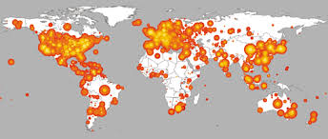
Evolution of Access Control
Circa 2000: network services ran as root/admin
One vulnerability and host was compromised
And could be used to take over much of the Internet – WORMS!

Slide 3
Evolution of Access Control
Effort to confine network services to protect hosts
E.g., Linux Security Modules framework
Network services and others run with limited permissions
DAC System
MAC System
Password
Files
Password
Files
Web
Server
Web
Server
Internal
Network
Internal
Network
Host
Kernel
Host
Kernel

Slide 4
Evolution of Access Control
Today: services run as program-specific subjects
However, many critical compromises of services
Is it time for another step in access control?

Slide 5
A Webserver’s Story …
Consider a university department webserver …
GET /~student1/index.html
/etc/
passwd
Apache
Webserver
Link
student1/ public_html
student2/ public_html
faculty1/ public_html

Slide 6
Example Attack Scenario

Slide 7
What Just Happened?
Serve
Webpage
Authenticate
Webserver
Not OK
OK
Serve
Webpage
Passwd File
Web Pages
OK
Not OK
Password
File
Web Pages
Authenticate
Passwd File
Web Pages
Systems and Internet Infrastructure Security Laboratory (SIIS)
Page

Slide 8
What To Do?
Been living with these problems since the early 2000s
What are the fundamental problems?
Processes are treated as monolithic entities
But, same permissions available for every system call
Process restrictions may depend on prior events
But, access control is stateless
Is it possible to monitor distinct events on the same process independently and statefully?

Slide 9
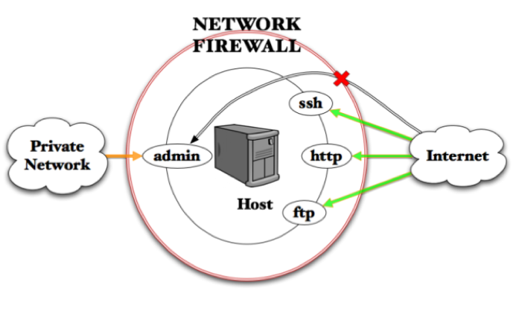
Motivation – Network Firewalls
Firewalls monitor network protocols individually and statefully
Network ports imply distinct entrypoints to each network and/or host
And prior communications may limit authorized actions in future
Network
Ports
Adversary
Inaccessible
Machines
Adversary
Accessible
Machines
Destination IP
Source IP

Slide 10
Motivation – Network Firewalls
Firewalls monitor network protocols individually and statefully
Network ports imply distinct entrypoints to each network and/or host
And prior communications may limit authorized actions in future
Process
Syscalls
(entrypoints)
Network
Ports
Adversary
Inaccessible
Resources
Adversary
Accessible
Resources
Adversary
Inaccessible
Machines
Adversary
Accessible
Machines
Destination IP
Source IP
Resource
Label
Process
Label

Slide 11
ProcWall Design Goals
Develop a system defense that can restrict/log
resources accessed by individual syscall invoocations
Should not require programmer code changes
Should provide context-sensitive protection for individual syscalls (entrypoints)
Should track and apply state to govern syscalls
Should be simpler and more efficient than program
Notes:
Why all fail because they don’t take into account both program and system

Slide 12
ProcWall PW Approach
How do we monitor without changing program code?
Userspace
Operating System
Students
✔
File
Passwd
Serve
HTML
File
/home/
student/
home.html
✗
.edu
webserver
Access Control
PW
Dir
???
???
Check
Passwd
IPC
Signal

Slide 13
ProcWall PW Approach
How does ProcWall check context-sensitive policies?
Userspace
Operating System
Students
File
Passwd
Serve
HTML
File
/home/
student/
home.html
.edu
webserver
Access Control
PW
Dir
Check
Passwd
IPC
Introspect
Signal
Notes:
We need to overcome system defense limitations of not knowing about program. How?

Slide 14
How Does ProcWall work?
Per-entrypoint policies for context-sensitive/stateful checks retro- fitting iptables rules and modules
Hardware-based process tracing to provide contexts efficiently and securely to the kernel – e.g., Intel PT
Processor
Trace
Decoder
CPU w/
Processor
Trace
Control
Flow
Binary

Slide 15
Context-Sensitive Example
Limit entrypoints that can access “protected” files
Serve
HTML
File
1 serve(char *html_f) {
2 open(html_f);
3 }
4 check(char *p) {
5 open(p);
6 }
.edu
webserver
Check
Passwd
Introspect
Process Context | Allowed | Generally
Line 2 | Files in web directory | Files permitted for adversaries
Line 5 | Legitimate password files | Files protected from adversaries

Slide 16
What Problems Can ProcWall Address?
ProcWall can control one syscall based on properties of a previous syscall
Using input from an “adversary-controlled” resource for other system calls
1 serve(char *src) {
2 fd = open(src); // adversary control?
3 read(fd, buf, size);
4 filter(buf); // filter bad input
5 open(buf); // open filtered name
6 }

Slide 17
ProcWall Stateful Policies
ProcWall can control one syscall based on properties of a previous syscall
Using input from an “adversary-controlled” resource for other system calls
Program filtering can fail
1 serve(char *src) {
2 fd = open(src); // adversary control?
3 read(fd, buf, size);
4 filter(buf); // filter incorrectly
5 open(buf); // ProcWall restricts
6 }

Slide 18
ProcWall Stateful Policies
ProcWall can record key states to guide defenses in future ops
Record receipt of adversary-controlled data to guide defenses for use of that data
Serve
HTML
File
1 serve(char *src) {
2 fd = open(src);
3 read(fd, buf, size);
4 filter(buf);
5 open(buf);
6 }
.edu
webserver
Check
Passwd
Introspect
Process Context | ProcWall Action | State Recorded
Line 2 | Check whether “src” may be adversary-controlled file | Store “safe” or “adversary” with fd
Line 5 | Restrict/log if: (1) “adversary” fd state and (2) opens “adversary-inaccessible” file | -----

Slide 19
Using ProcWall
Some simple policies to enforce…
Context-sensitive: Restrict entrypoints for
untrusted or secret resources
(2) Stateful: Restrict/authorize permissions
after a determining event
Web
Server
Web
Server
Web
Server
(t1) Use
Untrusted
Input
(t2) Limit Perms for
2nd syscall
Use untrusted
inputs
Use secret
inputs

Slide 20
Using ProcWall
What are the steps to utilize ProcWall?
Log legal operations – as for Linux MAC policies
(1) Pick a Program
(2) Log Its Contexts
Web
Server
Web
Server
PW logs:
(a) Contexts and Accesses
(b) States and Resultant (a)’s

Slide 21
Using ProcWall
What are the steps to utilize ProcWall?
Automatically generate policies from those logs
(3) Generate Its Rules
PW
Log
Generate PW Rules
From (a) and (b)
PW
Rules

Slide 22
Using ProcWall
What are the steps to utilize ProcWall?
Install rules to monitor/protect program executions
(4) Monitor the Running Program
Web
Server
Install Rules
in PW
PW Monitors
Process

Slide 23
ProcWall Effectiveness
Saves complexity and overhead for programs
Because ProcWall constrains the result of resolution not the resolution process
Complex for programmers to use open, openat, openat2
Saves from performing extra syscalls to collect file metadata
Can check many resource
properties (more flexible)
(2) Ensures expected results
in one syscall (efficiency)
(3) Resilient to race
conditions in OS namespaces
Use multiple roots, MAC labels (high/low), etc.
Do not have to run multiple
system calls to filter
All checking managed
by the system

Slide 24
Summary
Mandatory access control for processes - since 2005
Still lots of obvious (in hindsight) vulnerabilities are exploited
ProcWall (PW) extends MAC w/ context-sensitive and stateful control
Like a stateful firewall, but for individual process entrypoints (contexts)
Leverages hardware-based process tracing to identify contexts
More advanced defenses can be supported as well
More expressive contexts – call stacks and control flows
Decentralized Information Flow Control (DIFC)
Enhances provenance techniques
Happy to discuss help in using and/or more advanced examples

Slide 25
Next
DEMO

